Slide 1
The Role of Assessment in Decolonizing and
Indigenizing ECE
Elizabeth Jaeger, PhD
David Sul, PhD
University of the Virgin Islands
Presented at:
Indigenizing Early Childhood Education in the Caribbean
University of Guyana, Early Care and Education
May 15th, 2026

Slide 2

Goals for today
Identify ways in which assessment functions as a means of oppression
1
Describe how this is rooted in the assessment development process
2
Discuss its consequences for ECE research and practice
3
Explain how assessment development can be used to support liberation
4
Consider implications for the field and its researchers
5

Slide 3

ASSESSMENT

Slide 4
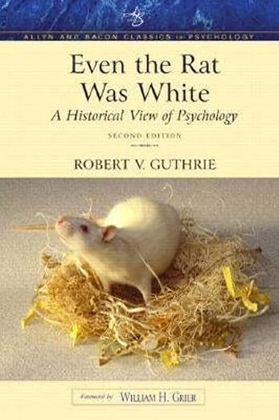
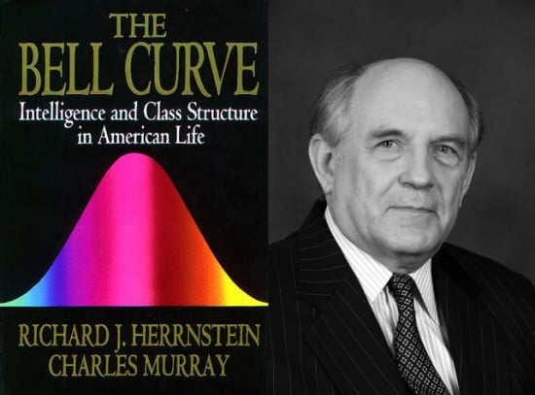
Assessment as a means of oppression
The ”brass instruments” of psychologists
  Focused on individual differences assumed to be universal
  Part of social Darwinism and the eugenics project
  Military tests; IQ tests
Have we ever gotten past this?
  No, despite some good intentions

Slide 5

The Assessment Development Process
According to Sul (2019), problem starts at beginning and results in measurement disjuncture
  Defined as “…the misalignment that occurs when elements of an instrument development process from one worldview are applied to the instrument development process of another worldview” (Sul, 2019, p. 7).
All assessment develops within a particular world view

Slide 6
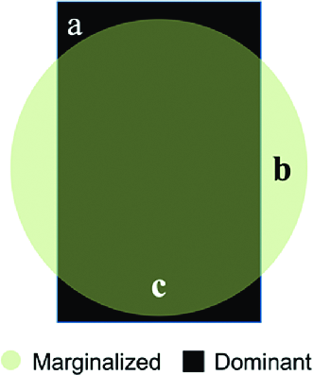
Measurement Disjuncture Consequences
a – penalizes those who have limited exposure to the dominant world view
b – gives them no credit for what they know outside of the dominant world view
c– forces the assessed to shift their world view to dominant one in order to “perform” on the assessment

Slide 7
Implications of measurement disjuncture
No adaptation of existing tests can resolve the issue
  Adaptations of test items or testing conditions do not address the fundamental question of how constructs are defined to begin with
    Alex and the mailbox
  From scientific point of view, fundamentally it also a construct validity issue Interpretations of results always fundamentally unknowable without it.

Slide 8
An example from ECE Research
Examined psychometric properties of the Virgin Islands Quality Rating and Improvement System
  Are QRIS ratings measuring a unidimensional construct of quality?
    Consist of different quality standards (Qualifications; Classroom practices; program operations; family-community partnerships)
  Do these ratings predict child outcomes at kindergarten entry?

Slide 9
Results of IRT analysis
(Jaeger, Mills, & Braitwaite-Hall, 2024)
Statistical Findings
What do they mean?
Very strong unidimensional construct
  Nearly all items contributed
Classroom quality measures embedded also resulted in unidimensional constructs
Some ordering of items issues
Distinguished 3-4 groups of centers
ECE Quality is a universal construct?
QRIS ratings of whole programs are justified?
Would the scores based on IRT predict child outcomes at classroom levels?

Slide 10
Measurement Disjuncture in Action
IRT QUALITY MEASURE CHILD OUTCOMES
CLASSIC THIRD VARIABLE PROGRAM
Similarity to Dominant Worldview Ideal

Slide 11
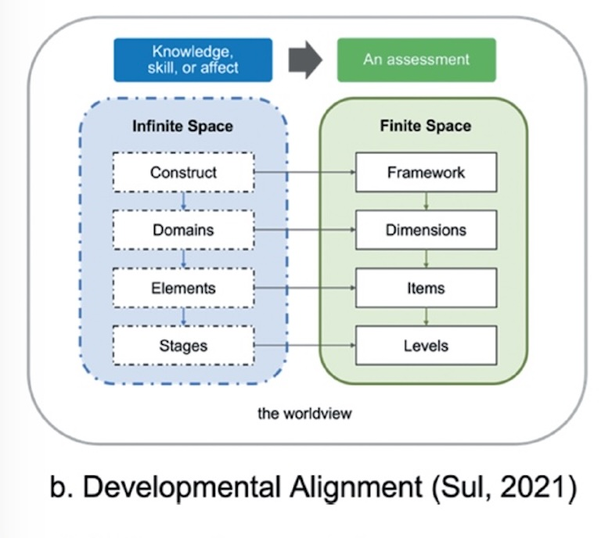
Culturally Specific Assessment (Sul, 2024)
Indigenizes ECE by:
  Defining constructs within context of a community’s world view
  Using indigenous research methods to name constructs and create the assessments

Slide 12
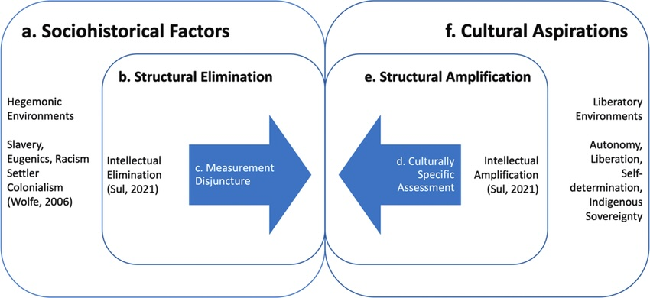
Promoting liberation: the measurement-response dialectic

Slide 13
CSA Framework: Implications for ECE Research and Practice
Grounding in critical perspectives promotes decolonization
Naming, centering and prioritizing worldviews as first step is critical to indigenizing the field
Possible to such develop assessments that can be used in quantitative research

Slide 14

CSA Framework:
Implications for us as researchers
Radically change our positionality as the “experts”
Acting as a facilitator, not a leader
Merely scaffolding until ready to independently create assessments
Constant reflection – on all levels – is key
Trust your lived experience
Interrogate what you were taught in formal education
Advocate for resources for CSA
Point out limitations when not using them.
COLLABORATION

Slide 15
References
Jaeger, E., Mills, F., & Braithwaite-Hall, S. (2024) Jaeger, E, Mills, F., & Braithwaite-Hall, S. (2024, June). Using IRT Methods to Validate a Quality Rating and Improvement System for the US Virgin Islands. Poster presented at the National Research Conference on Early Childhood, Arlington, VA.
Sul, D. (2019). Sul DA. Reclaiming educational autonomy and minimizing measurement disjuncture through a culturally specific assessment development process [Paper presentation]. Culturally Responsive Evaluation and Assessment (CREA), Chicago, IL . Available from https://www.researchgate.net/publication/332275884_Reclaiming_educational_auton omy_and_minimizing_measurement_disjuncture_through_a_culturally_specific_asse ssment_developmentprocess
Sul, D. (2024). Situating culturally specific assessment development within the disjuncture-response dialectic. In: W. Fisher Jr. & L. Pendrill L. (Eds), Models, Measurement, and Metrology Extending the SI: Trust and Quality Assured Knowledge Infrastructures. Germany: De Gruyter.; 475-500. Available from: https://doi.org/10.1515/9783111036496-015

Slide 16

Contact Information:
  Elizabeth Jaeger, PhD
  University of the Virgin Islands
  ejaeger@uvi.edu
  340-693-1271

