Slide 1
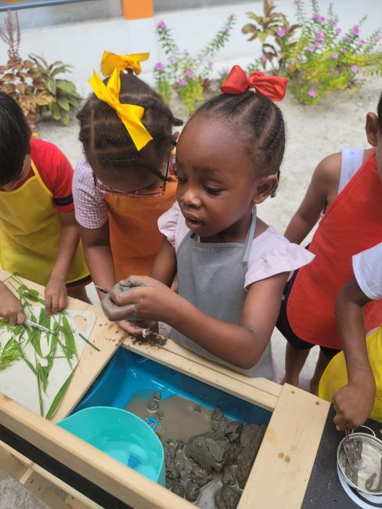
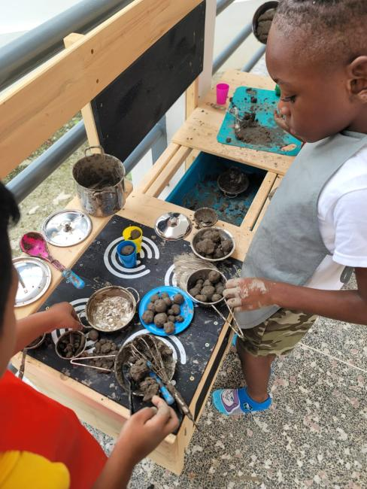
WHAT MUD MEANS TO ME
Children’s Reflections on Mud Kitchen Play
University of Guyana Early Childhood Centre of Excellence
Indigenizing Early Childhood Education in the Caribbean Conference 2026
Presented by: Mrs. Althea Edwards and Mrs. Godryne Wintz

Slide 2
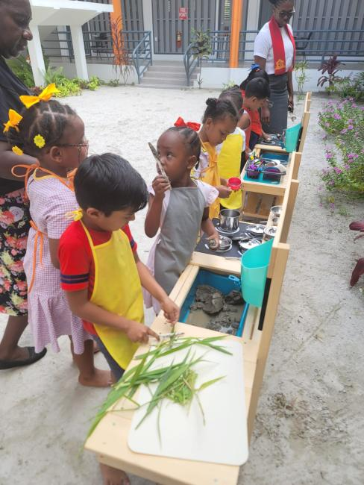
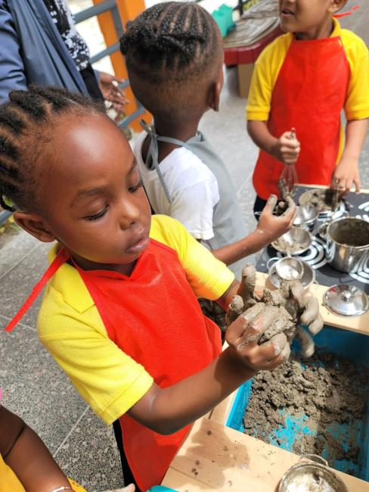
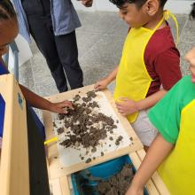
“Before we discuss the research, we invite you into the experience.”

Slide 3
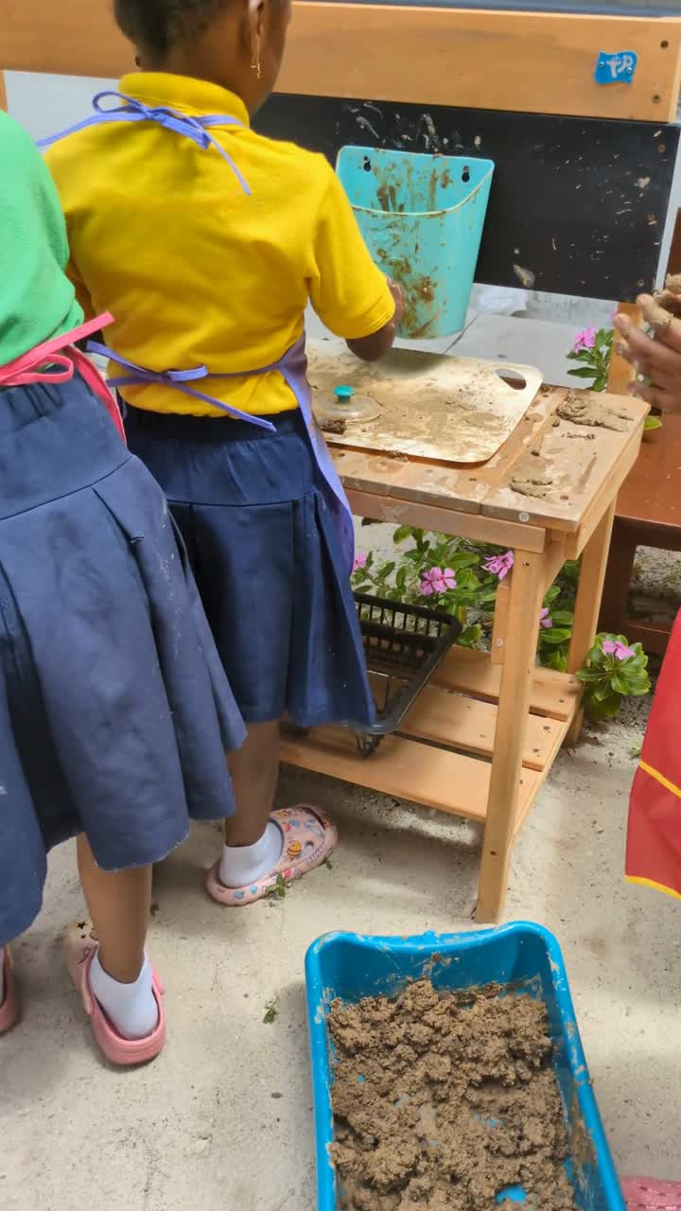
laughter
mixing
conversation
pouring
movement
sensory immersion

Slide 4

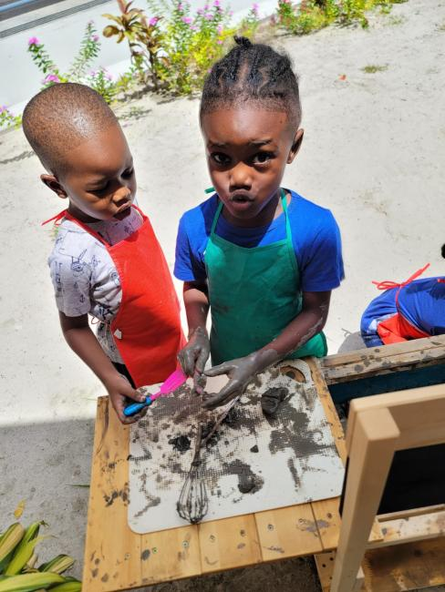
Why Mud Matters in Early Childhood Education
  creative expression and invention
  problem-solving opportunities
  stress reduction
  cooperative play possibilities
  stronger immune systems
  growing affection for the things on our earth

Slide 5

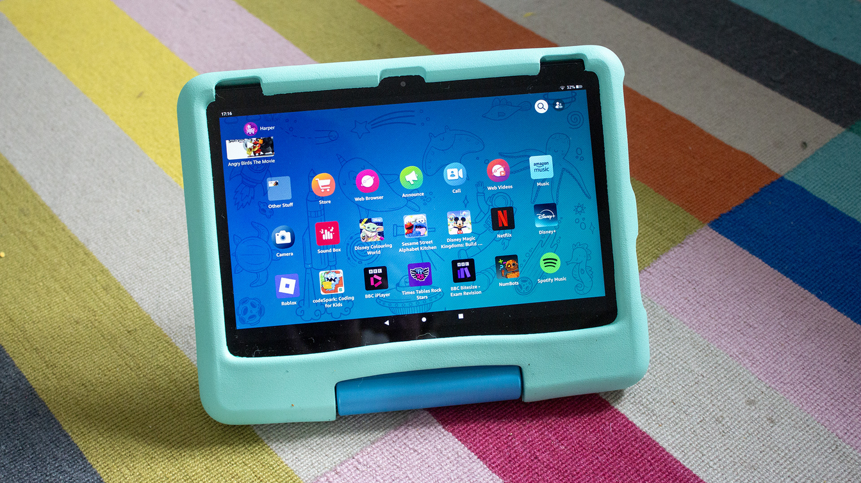
Framing the Problem -
Contemporary Childhood and the Disappearing Nature Experience
  Increasingly structured childhoods
  Reduced opportunities for open-ended play
  Greater reliance on screens and indoor activities
  Outdoor spaces becoming more restricted
  Natural play environments increasingly disappearing
  Children experiencing less sensory engagement with nature
Semple-McBean, Wintz, & Lashley (2025); Brussoni et al. (2015); Louv (2008); Elliott & Davis (2005)

Slide 6
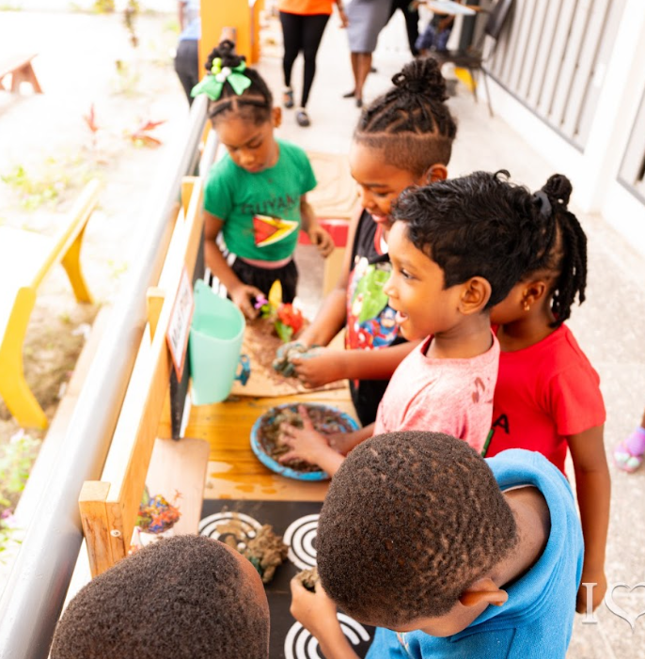
Literature Review
Nature play supports emotional, cognitive, social, and physical development (Dankiw et al., 2020; Elliott & Davis, 2005)
Learning occurs through embodied interaction with the environment (Pyle et al., 2018; Vygotsky, 1978)
Mud supports sensory exploration, experimentation, and creative thinking. (Jensen & Bullard, 2002; Waite, 2017)
Open-ended materials encourage deep engagement and “flow” experiences. (Fitzgerald, 2015)

Slide 7
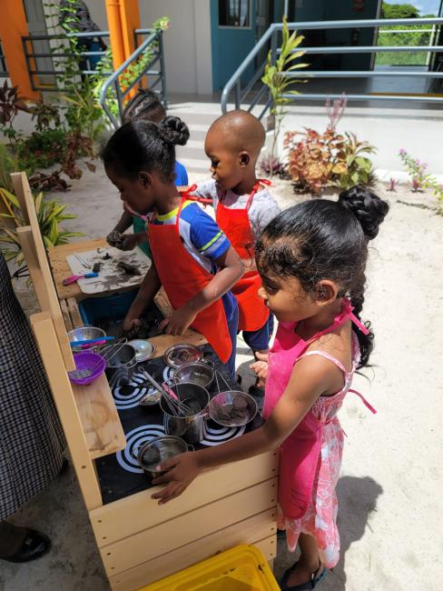
Literature Review
Children construct shared narratives and social roles through play. (Wood, 2014; Rogoff, 2003)
Flexible materials support collaboration and imaginative transformation. (Nicholson, 1971; Bruce, 2011)
Sensory play environments evoke joy, curiosity, uncertainty, and emotional expression. (White, 2012; Fruin, 2020)
Emotional responses to muddy play vary across children. (Cevher-Kalburan, 2015; Menezes, 2022)

Slide 8
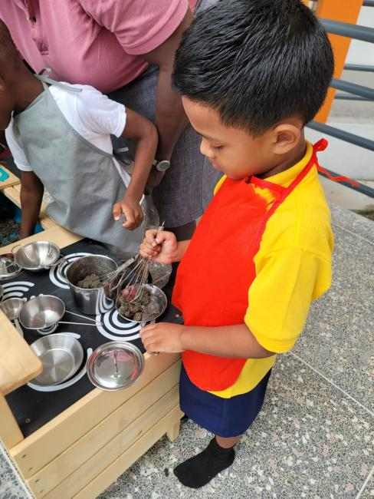
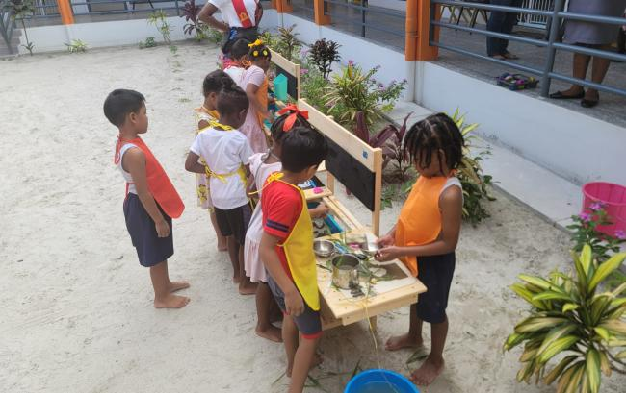
Research Methodology
  Qualitative child-centred design
  Ethnographic Sensibilities
  Photo elicitation interviews
  naturalistic observation

Slide 9
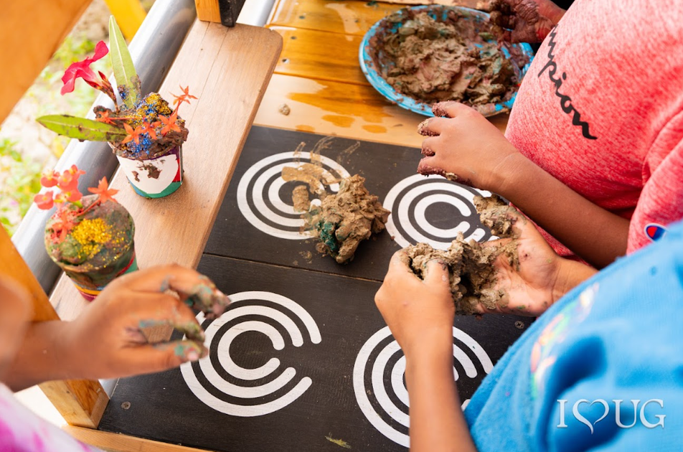
Participants and Data Collection
Participants
  Nursery Two children at UG-ECCE
  20 children between 5–6 years old
  The oldest group within the early childhood setting
Mud Play Sessions
  Mud kitchen play formed part of the children’s everyday curriculum
  Four mud play sessions were observed
  Sessions were documented using photographs and video recordings
Interview Process
  Children participated in photo-elicitation interviews
  Interviews conducted in four small groups of five children
  Visual prompts supported reflection and discussion

Slide 10
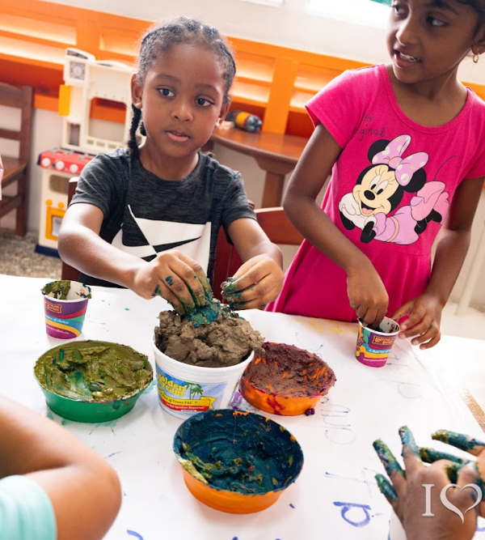

Entering the Mud Kitchen
  A Glimpse Into the Interview Process
  Children immediately identified themselves in the photographs and videos
  Several moved closer to the screen and pointed excitedly
  Conversations shifted between memory, imagination, and sensory reflection
  Children repeatedly referenced peers and shared experiences
Observation
The visual prompts supported memory recall, emotional reflection, and conversational engagement.
  Children’s Voices
  “We cooking roti.”
  “Where am I?”
  “That’s me!”
  “My friends helping.”
  “It soft.”

Slide 11
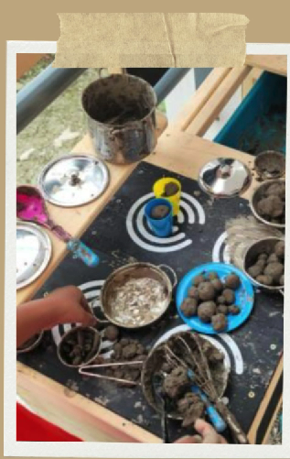
Entering the Mud Kitchen –
A Contextual Vignette
  Sensory Meaning-Making
  Identity and Agency
“That’s me!”
“Don’t call me baby.”
Children first located themselves within the visual narrative, demonstrating self-recognition and agency.
“It soft.”
“Cold.”
“Like Play-Doh.”
“This one wet.”
Children interpreted mud through texture, temperature, and sensory comparison.
  Imagination and Culture
“We cooking roti.”
“I making cake.”
“This fish soup.”
“We put worms in it.”
Mud became food, stories, and culturally familiar experiences through imaginative transformation.

Slide 12
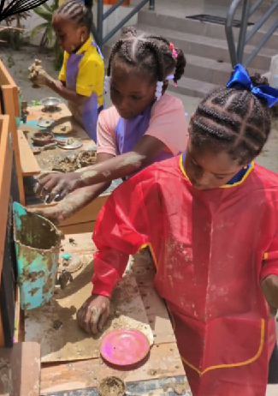
Entering the Mud Kitchen –
A Contextual Vignette
  Social Collaboration
“My friends helping.”
“We making it together.”
“She stirring it.”
“I give him some.”
Children collaboratively negotiated roles, materials, and shared play experiences.
  Emotional Complexity
“We“Happy.”
“Good.”
“Fun.”
“I feel sad.”
“I don’t know.”
Children’s responses revealed both enjoyment and emotional complexity within muddy play experiences.
  Immersion and the Desire to Return
“Today.”
“Tomorrow.”
“Every day.”
Children expressed a strong desire to revisit the experience, suggesting deep engagement and emotional connection.

Slide 13
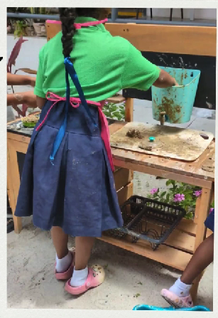
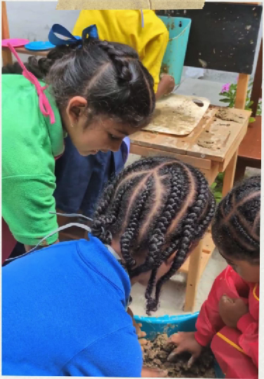
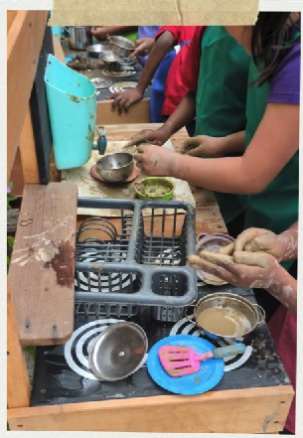
Discussion
  What Children’s Reflections Reveal
The findings suggest that:
  play is embodied
  meaning emerges through interaction
  sensory experiences matter
  children interpret play in deeply personal ways
Most importantly:
Children were not passive participants in play.
They were active meaning-makers.

Slide 14
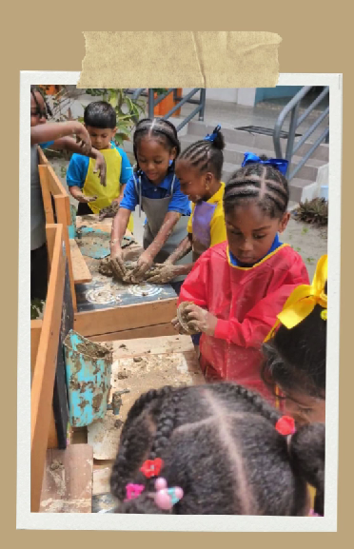
What Mud Meant to the Children
  Conclusion
  sensory experience
  imagination
  relationship
  emotion
  meaning

Slide 15
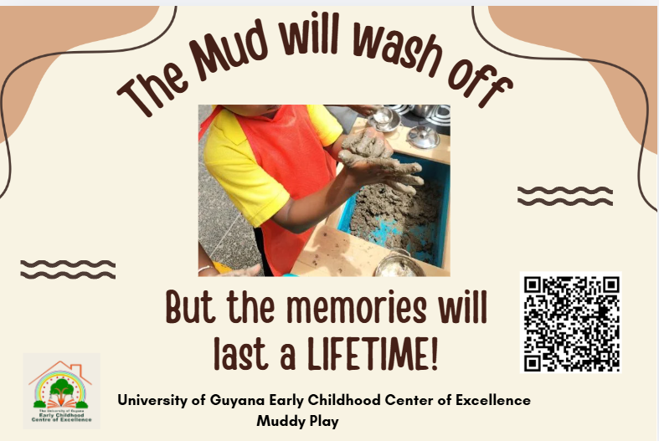

Slide 16




THANK
You

