Slide 1
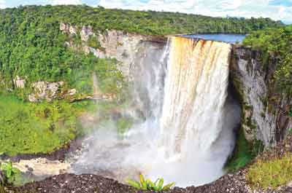
Indigenizing Early Childhood Education in the Caribbean Region
Jaipaul L. Roopnarine, Ph.D.
Professor of Human Development and Family Science
Syracuse University, Syracuse , New York
Professor Extraordinary of Developmental Psychology Anton de Kom University of Suriname
Professor, University of Guyana

Slide 2
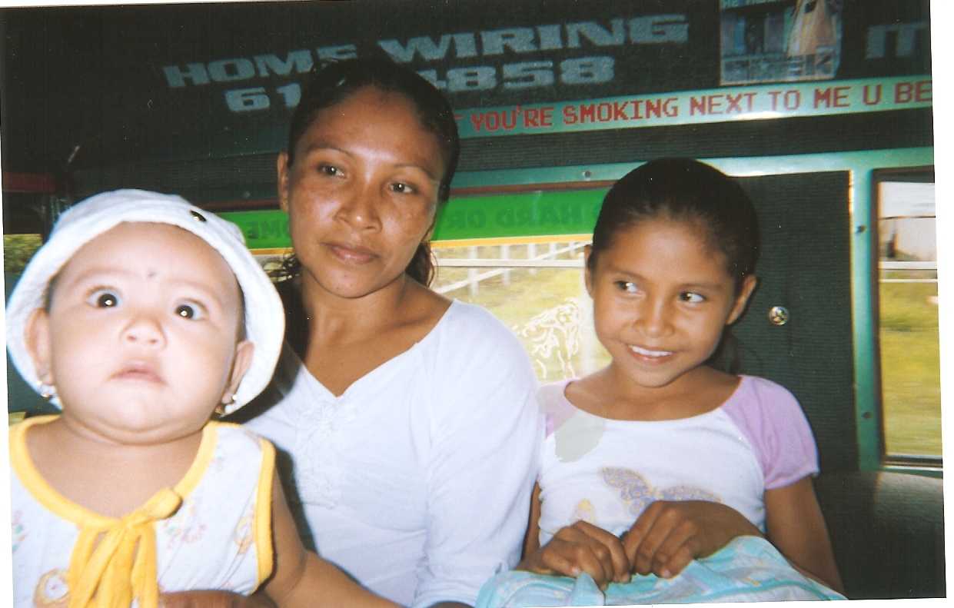
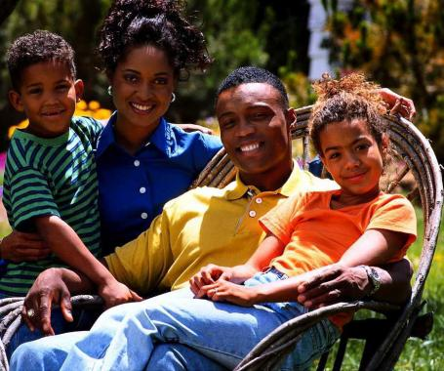
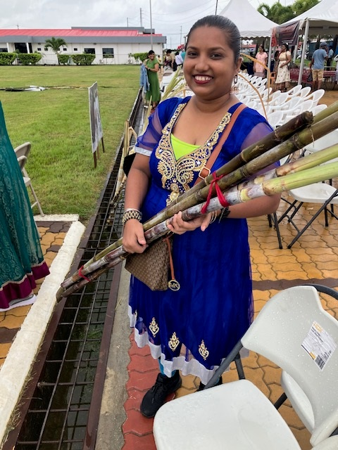
Acknowledgements
I acknowledge with respect the Onondaga Nation, Firekeepers of the Haudenosaunee, the Indigenous People on whose ancestral lands Syracuse University now stands
I acknowledge with respect the Indigenous People, those who are descendants of enslaved Africans and Indentured Laborers, and all other ethnic groups in Guyana

Slide 3
Focus
Conceptualization of Indigenization and Decolonization
Conceptualizing ECE
Efforts at indigenizing ECE in a few Caribbean countrie

Slide 4
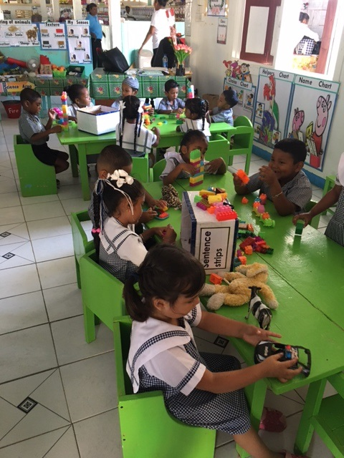

Slide 5
Conceptual Frameworks (Adair, 2006)
Importation
Implantation
Indigenization
autochthonization ( development of a “self-perpetuating discipline”)

Slide 6
Pancultural Perspectives (Berry; Greenfield, 2007; Thompson, 2016; McWorther, 2024)
Integration of western and global majority conceptions
(Reggio-Emilia globally, Portage Project---India)
Indigenous and cross-indigenous—what is particular and what may be similar across cultures (e.g., Risk and Protective Factors; historical trauma)
Employ pan-cultural theories to guide practices that have been tested across cultural communities (neo-constructivist perspectives, Vygotsky, ZPD; scaffolding)

Slide 7
Early Childhood Education-Pan-cultural
High Scope
Project Approach
Reggio Emilia
Creative Curriculum
Bank Street
UWI-Preschool Trinidad and Tobago—integrated Reggio and nature and indigenous practices
Mixed-age Programs
Roving Caregivers Program (developed in the Caribbean)
Portage Project

Slide 8
Decolonizing
Historical antecedents, namely slavery, indentured servitude, and the treatment of first nation peoples add to the complexity of the indigenization process
Should decolonizing precede indigenization?
Addressed simultaneously?

Slide 9
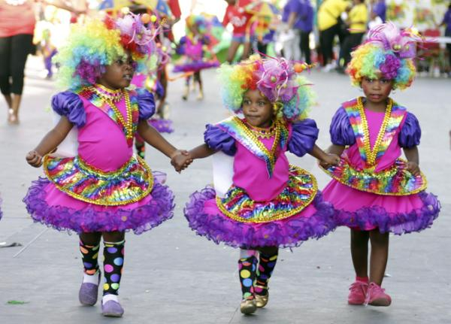
A Few Key Aspects of Decolonization
Facets of the decolonizing movement involve:
(a) self-determination
(b) deinstitutionalization of the colonial influence by centering local content in educational training
(c) reclaiming ancestral knowledge, and affirming human capabilities and dignity (Fanon, 1967; Hickling, 2020; Maynard, 2023; Nussbaum, 2011; Robinson et al., 2021; Thompson 2016)
(d) equity and social justice issues

Slide 10
Conceptualizing ECE in Cultural Context
Ethno-theories or internal working models of ECE practices and benefits (parents and educators)
Conceptions of childhood and developmental expectations
Biodevelopmental model—processes within the family as laying the foundation for children’s cognitive and social development
Intentional parenting for equity and justice (discontinuity and continuity between home and ECE environments (toys, materials), bias, racial and ethnic-socialization toward a just and equitable world (color consciousness)

Slide 11
Belief Systems About Early Development
Early developmental expectations of preschool-aged children
Parents and early childhood personnel hold unrealistic expectations of children
Beliefs about play and its role in cognitive and social development

Slide 12
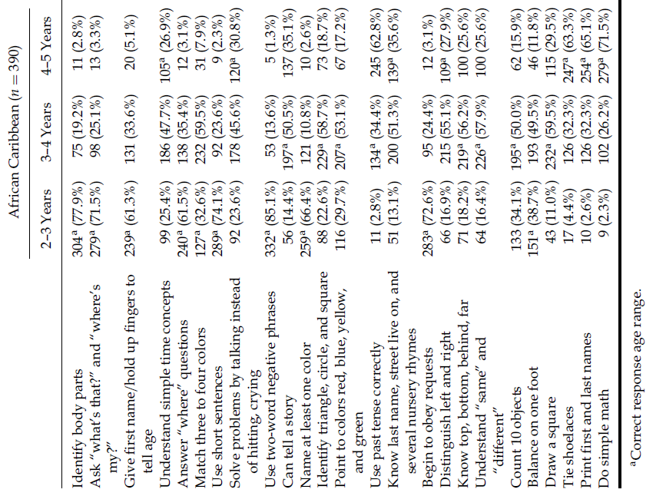

Slide 13
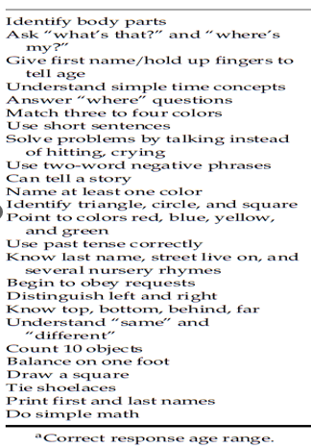
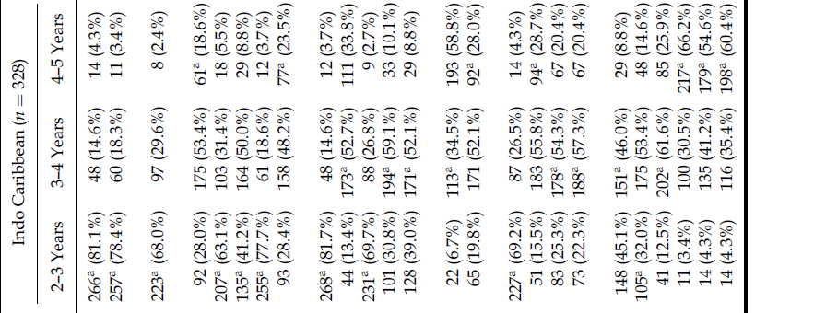

Slide 14
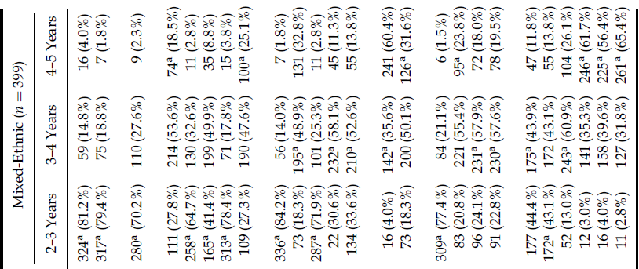

Slide 15
ECE and Risk and Protective Factors
ECE cannot be viewed independent of risk and protective factors
Family resources (educational materials, income and educational levels)
Family functioning (e.g., mental health, IPV, partner support and affection, conflict resolution strategies)
Parenting practices (e.g., guidance methods, cognitive engagement)

Slide 16
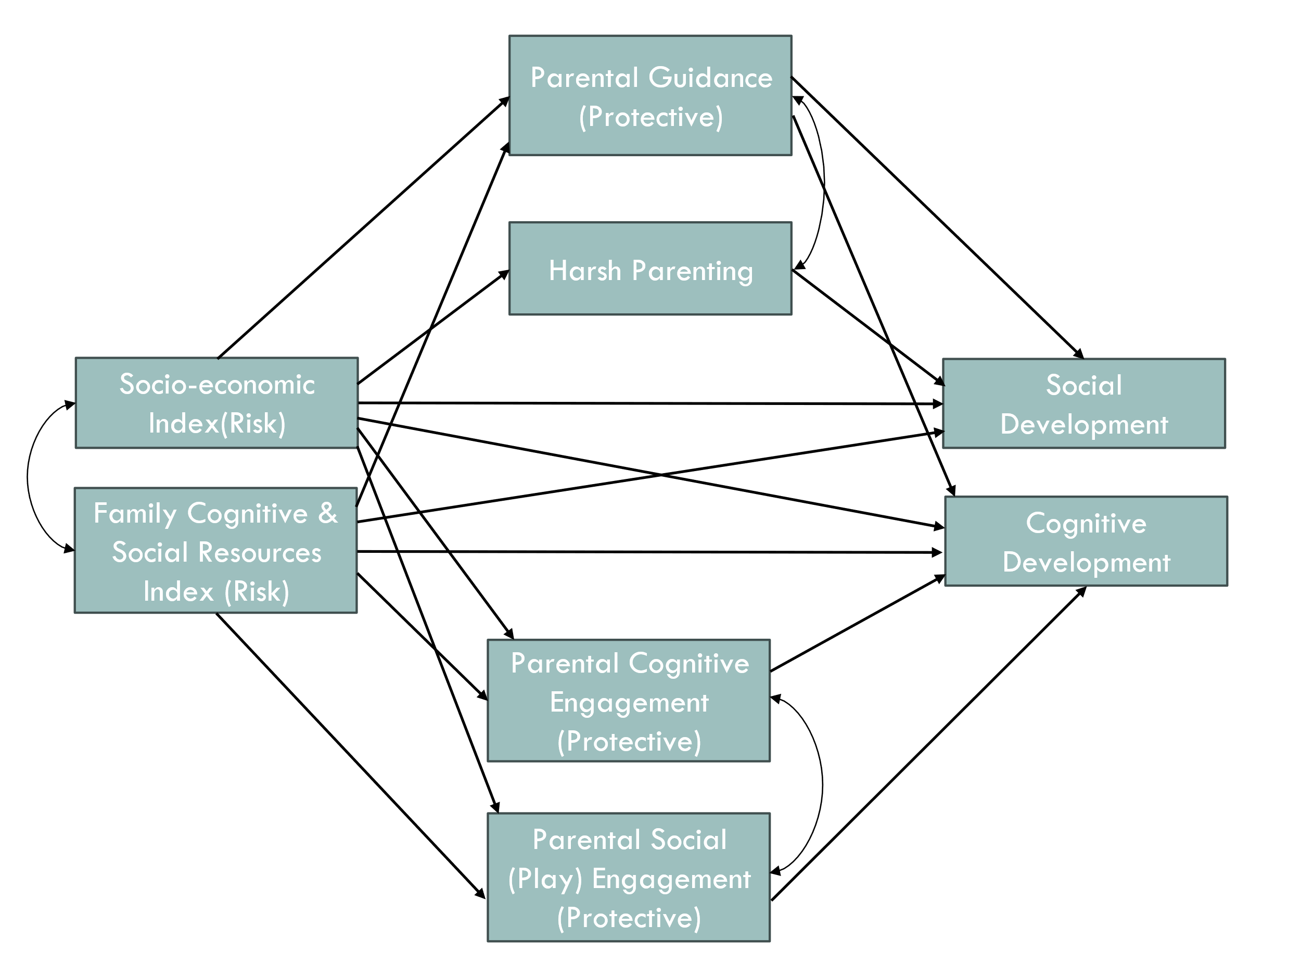

Slide 17
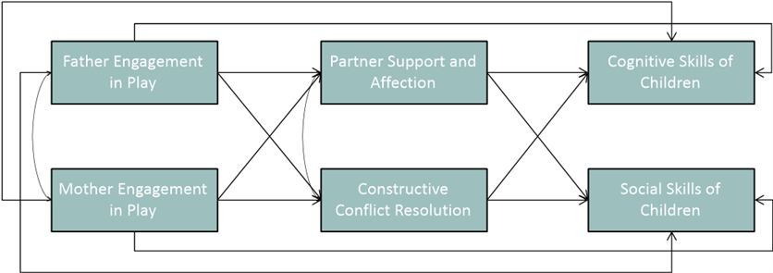

Slide 18
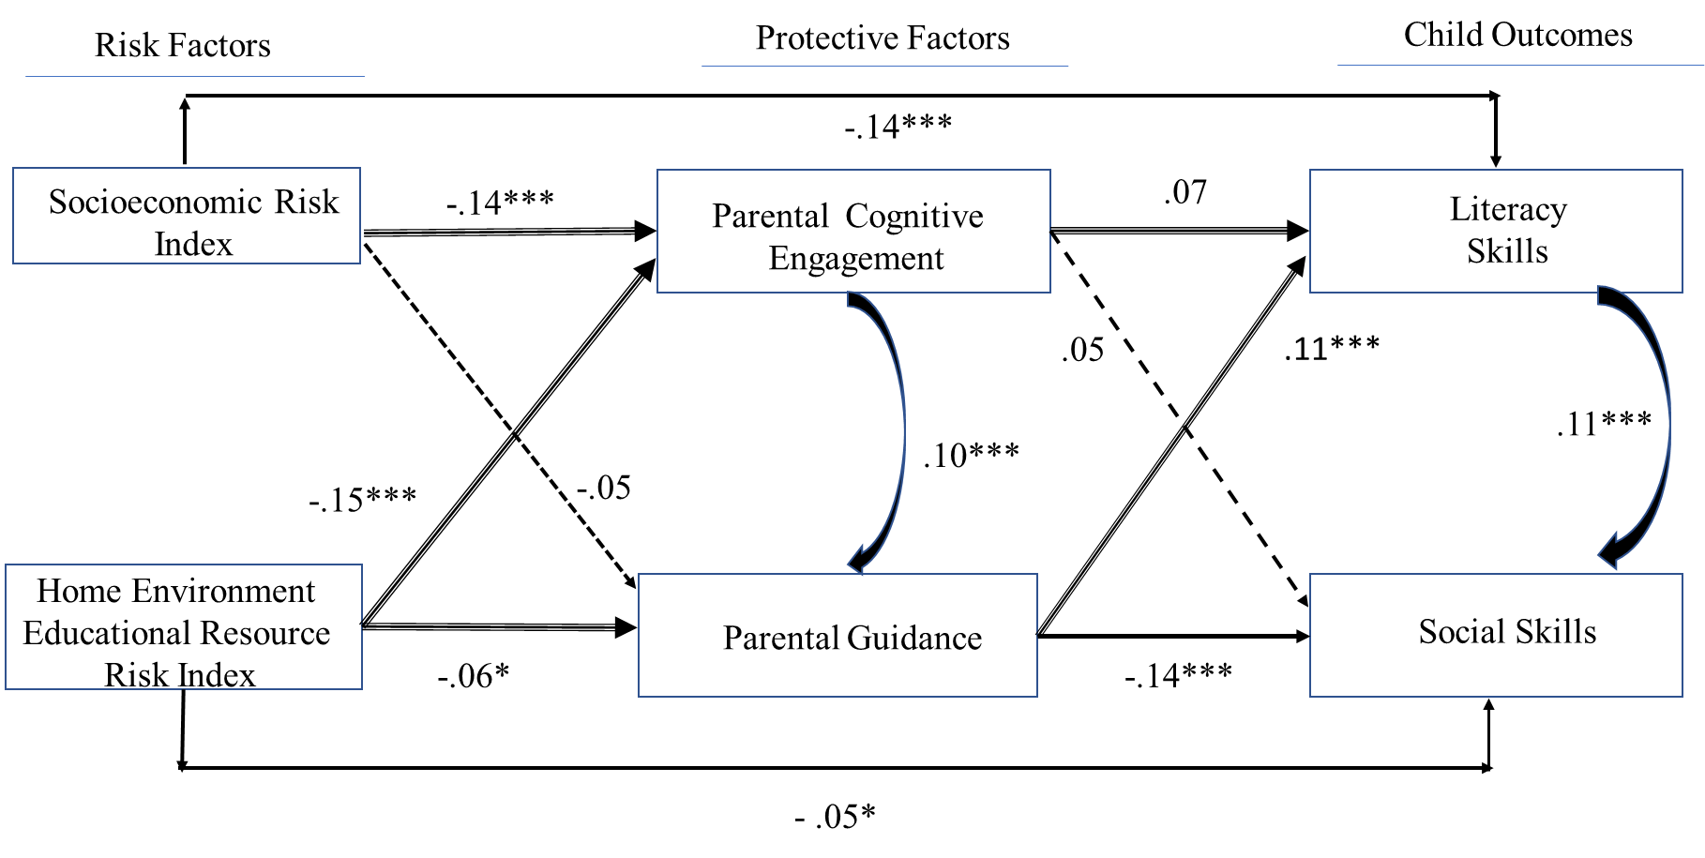
Figure 1
Standardized Path Coefficients for the Association Between Risk Factors, Protective Factors, and Child Outcomes
Note. The significant pathways are indicated by compound lines. Nonsignificant pathways are indicated by dotted lines.

Slide 19
Equity and Justice
Intentional Parenting for Equity and Justice
Proactive approach of addressing biases, modeling compassion, inclusion
Community building with other families to tackle inequality/biases
ECE/family partnerships

Slide 20
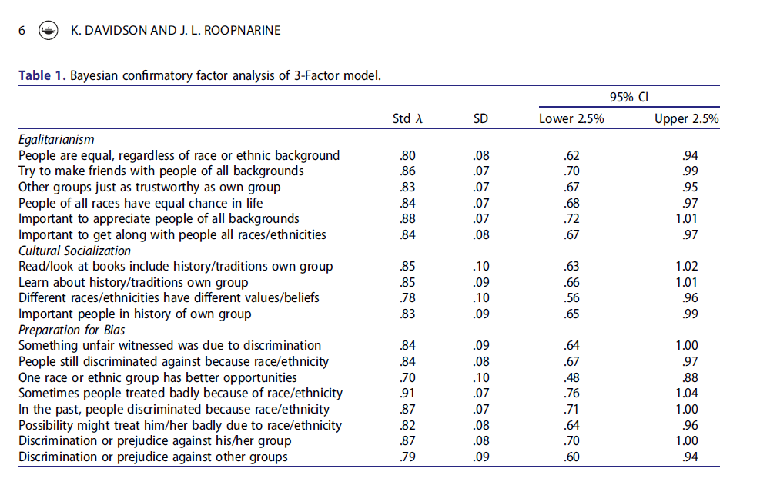

Slide 21
Internal Insecurity in Developing Knowledge Systems
Dr. Fantz Fanon’s groundbreaking interpretations of the psychological effects of racism on Black and brown people in a white-dominated colonized Caribbean.
His book “Black Skin White Masks” points to personal insecurity linked to skin color (colorism) that contributed to alienation and self-rejection
Does this exist today?

Slide 22
Key in Building Indigenous ECE
Indigenous concepts and theories
Research Centers
Training programs, certification
Ethics Training
Professional Organizations (Regional Association of Early Childhood Education)
Indigenizing methods of delivering early childhood education
Assessment instruments

Slide 23
Sociohistorical Approach
Emphasizes social construction—cultural apprenticeship, such as cultural activities, use of artifacts (tools) and historical dimensions of these processes
Human capabilities and funds of cultural knowledge
Focus more candidly on elements within the Caribbean context in defining psychological, epistemological, and cultural liberation from what was imposed by the colonial mindset

Slide 24
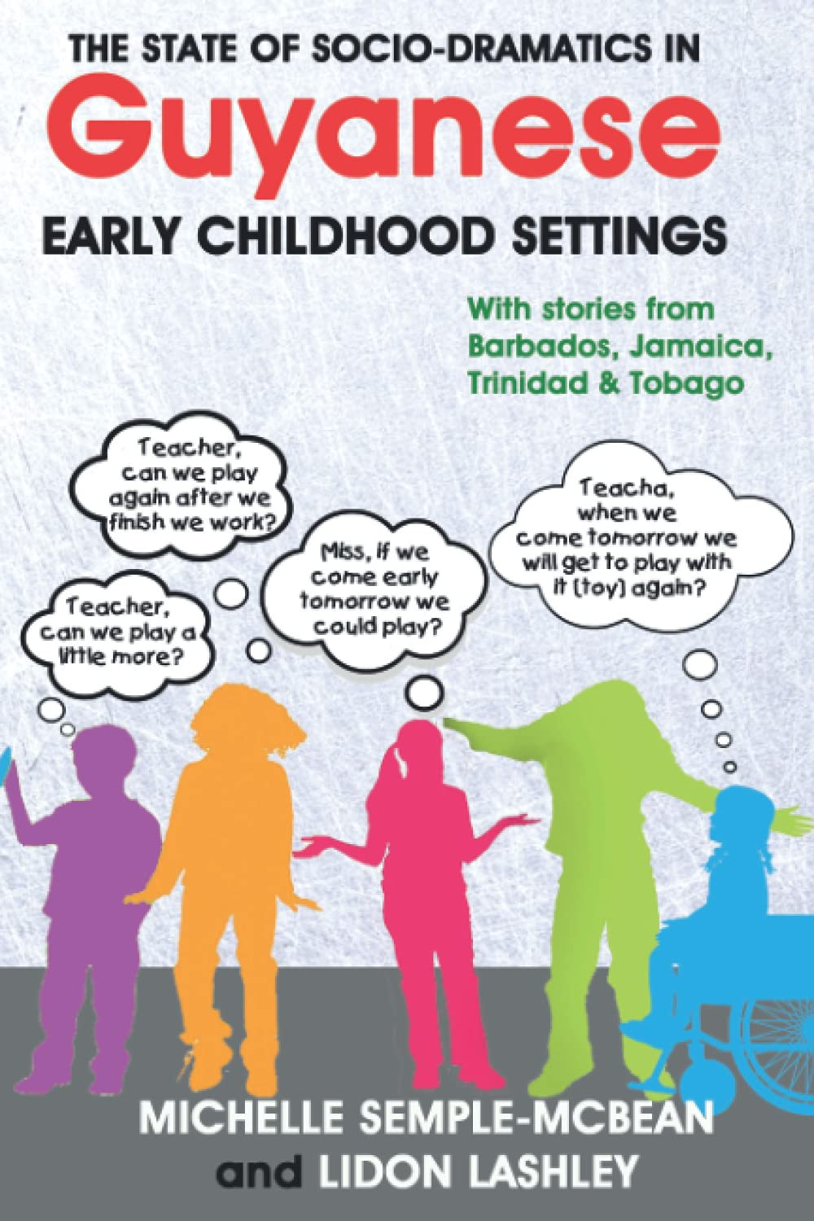
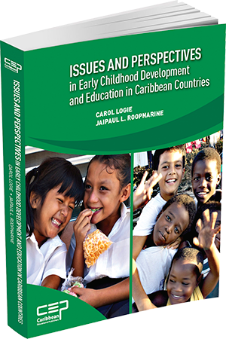
Examples of Knowledge Systems
Volumes on ECCE

Slide 25
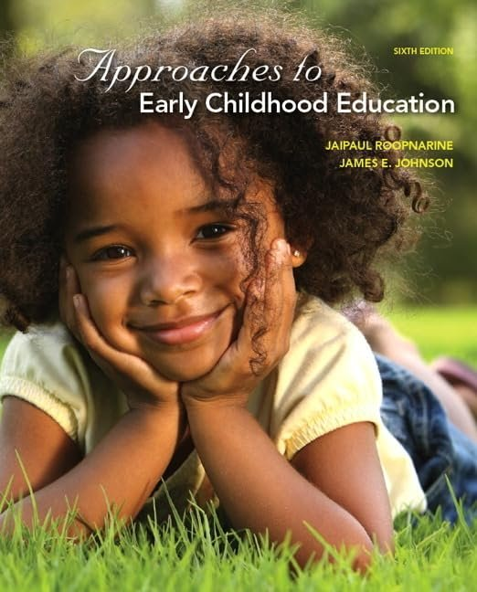

Slide 26
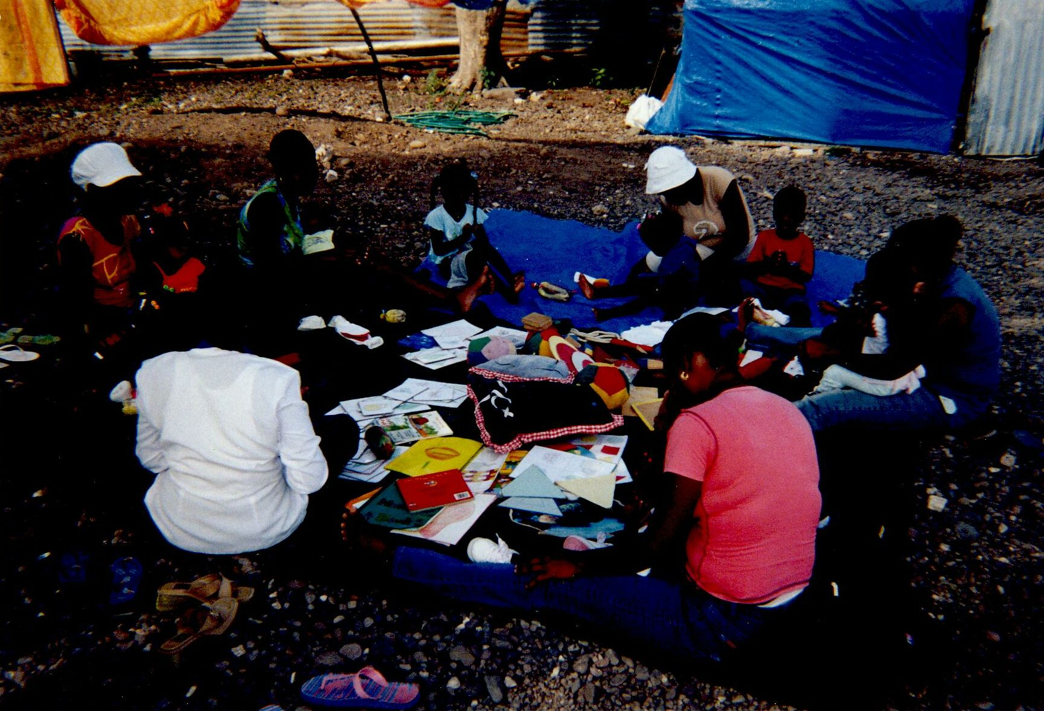
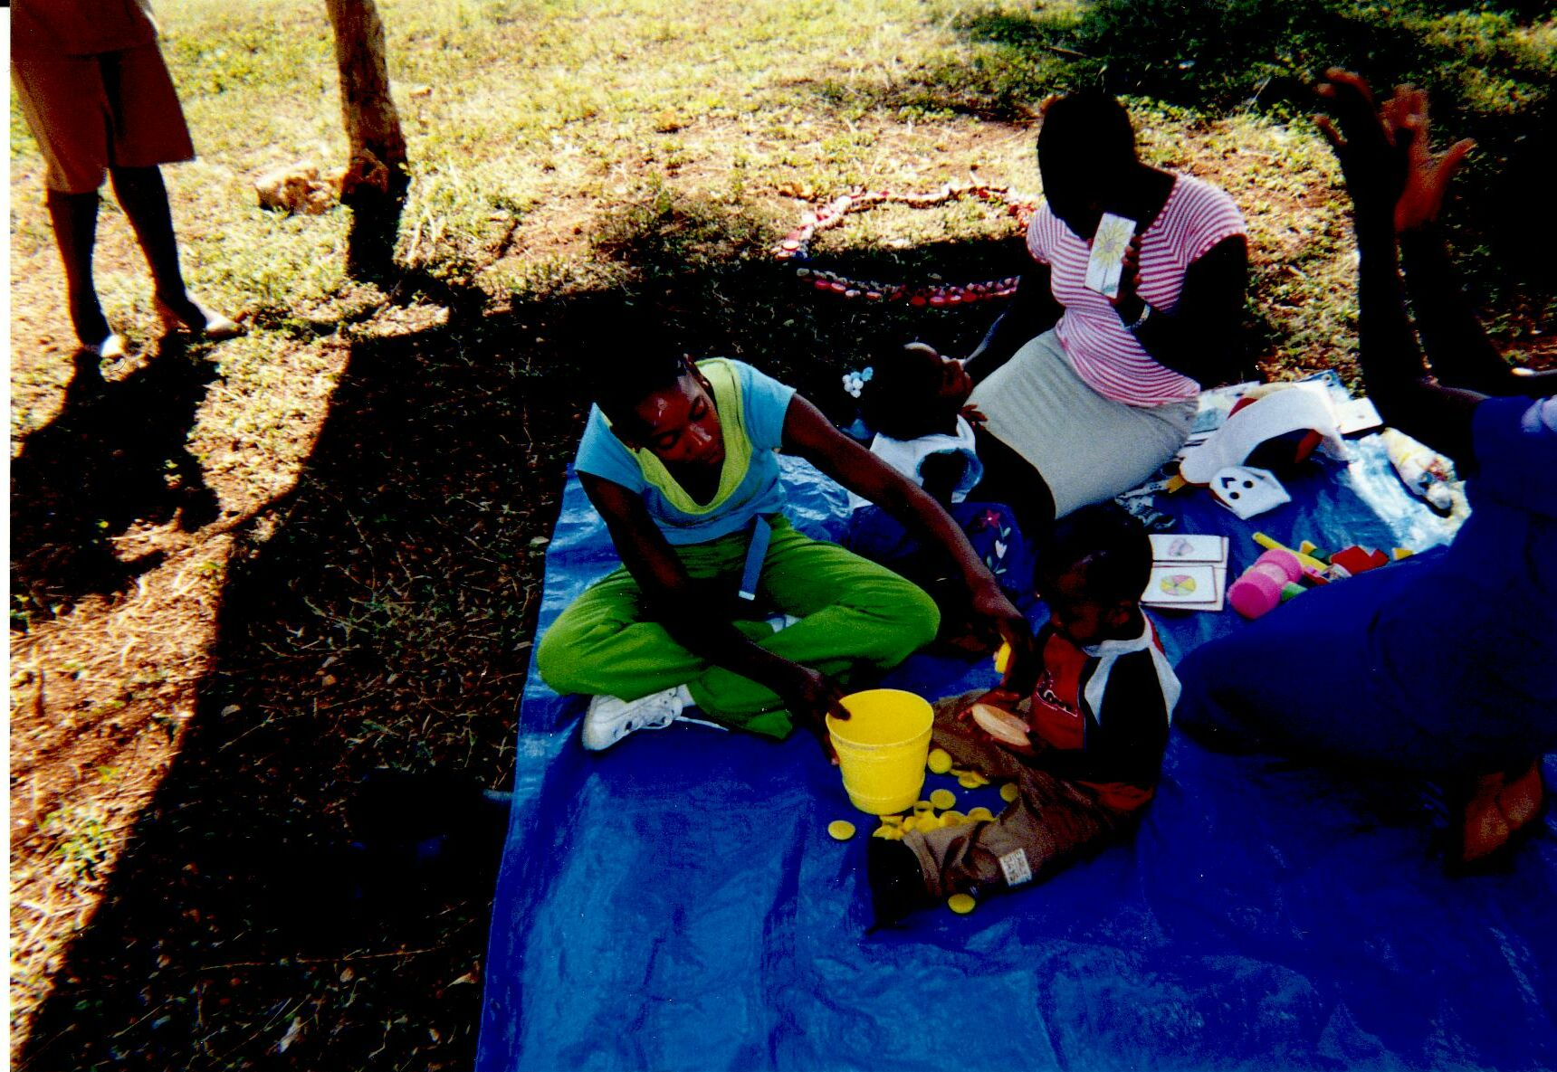
Roving Caregiving Program
Roopnarine, J. L. (2005). The roving caregiver program in Jamaica: Its theoretical and research foundations and efficacy. The Hague: Benard van Leer Foundation.
Home-based early intervention 0-3 yrs
30-60 minutes per week

Slide 27
Research Centers
UWI Early Childhood Research Centre, Trinidad and Tobago
UWI Early Childhood Research Centre, Mona
ECCE-University of Guyana
The Caribbean Center for Child Neurodevelopment – CCCN, St. Georges Medical School, Grenada

Slide 28
Neuroscience and Discipline
Grenada (Landon et al)
Caribbean Centre for Child Neurodevelopment—Conscious Discipline
Helping educators respond with calm, connection, and skill-building

Slide 30
Human Rights—Conscious Discipline
Empathy—acknowledging the child’s experience (child seen)
How do you accomplish this?
Name the feeling—You seem very frustrated. The child is understood!
Responding with empathy– helps to develop self-control, co-regulation
Describe the situation or desire—you wanted the drawing a certain way, but you could not!
This demonstrates understanding and reasoning behind the feeling
Provide support and regulate---it is hard—you can manage. Let’s breathe together

Slide 31
Summary
Empowering institutions and communities to be cognizant of and implement training programs to address the psychological impacts of colonial trauma.
Concerted efforts should be made to reclaim identity and culture by dropping the colonial mindset. This would require a systematic process of recovering and nurturing Caribbean history, culture, and languages.
Examination of western ECE approaches as having universal application in research, training, practices, and policy initiatives.
Enabling marginalized communities to chart a course for defining their own well-being rather than relying solely on those imported from North America and Europe.
Changing the ideologies of Caribbean researchers and practitioners.

Slide 32
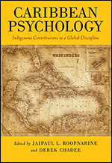

Slide 33
