Slide 1




Indigenising Early Childhood
Promoting ECD opportunities for Indigenous Peoples in Guyana: Research agenda for advancing Guyana Education Sector Improvement Project: Indigenous Peoples Plan, 2017
Zoyah Kinkead-Clark | The University of the West Indies, Mona

Slide 2
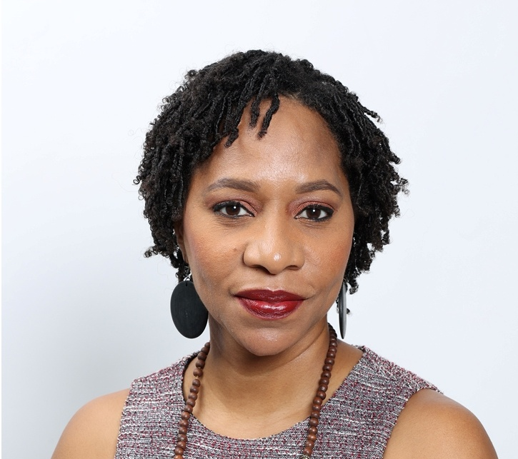
Introduction
Zoyah Kinkead-Clark
Professor, Early Childhood Care and Education, UWI Mona (Jamaica)
Deputy Dean, Graduate Studies and Research
Lead Examiner, Joint Board of Teacher Education, Early Childhood Programmes
Manager of the Dudley Grant Resource Centre
Kindergarten teacher for several years
Mother of three boys (11 year old twins and a five year old)

Slide 3
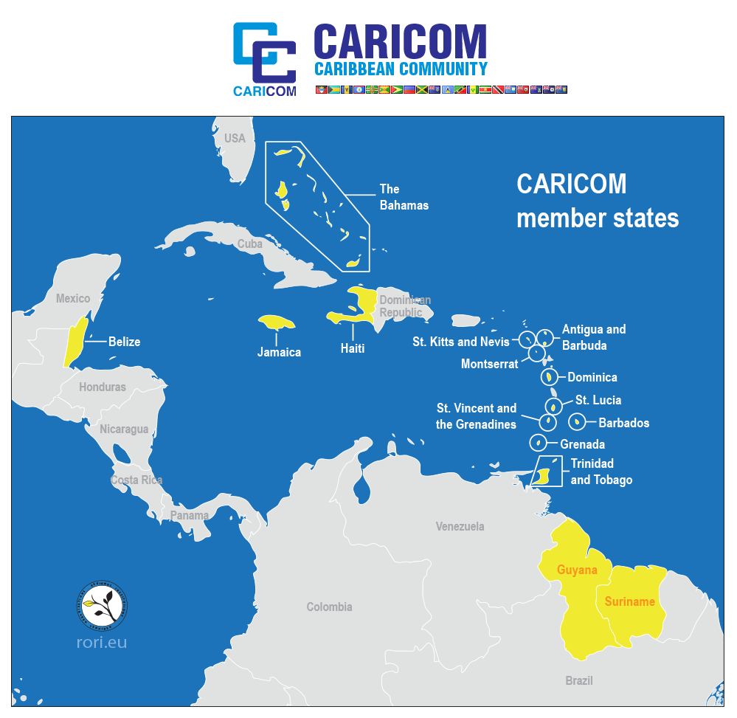
Background
As a regional group of over 20 countries (Antigua and Barbuda, Bahamas, Barbados, Belize, Dominica, Grenada, Guyana, Haiti, Jamaica, Montserrat, Saint Kitts and Nevis, Saint Lucia, Saint Vincent and the Grenadines, Suriname, Trinidad and Tobago, Anguilla, Bermuda, the British Virgin Islands, the Cayman Islands, Guadeloupe and Turks and Caicos with approximately 20 million people, the Caribbean has made significant strides to develop its early years programmes. Though geographically similar, each country is unique and faces nuanced issues which they must address as they aspire to advance the outcomes for their youngest citizens

Slide 4
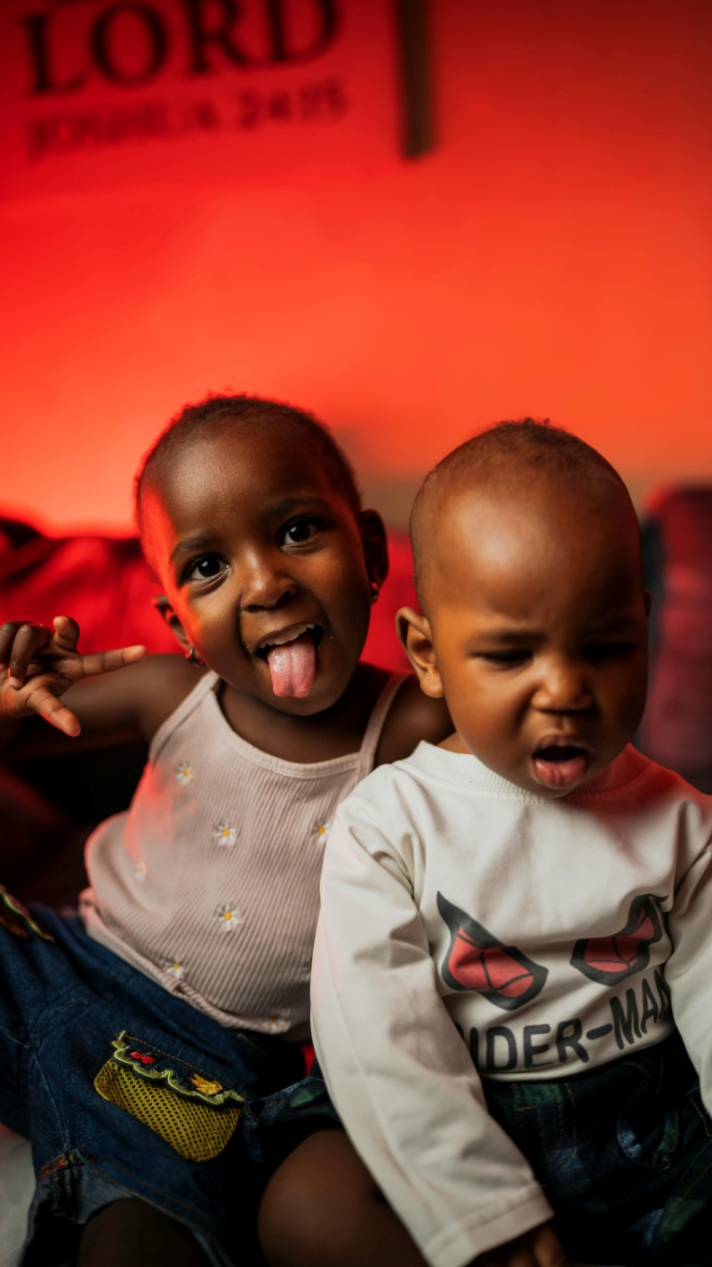
Overarching Goal
This study will explore critical issues relevant to advancing ECCE for select countries in the Caribbean in keeping with the objectives of the SDGs. Focus will be placed on ECCE for indigenous communities, children of resistance (those from adverse experiences, climate resilience, expanding ECCE and assessing programmes for children zero to three.

Slide 5
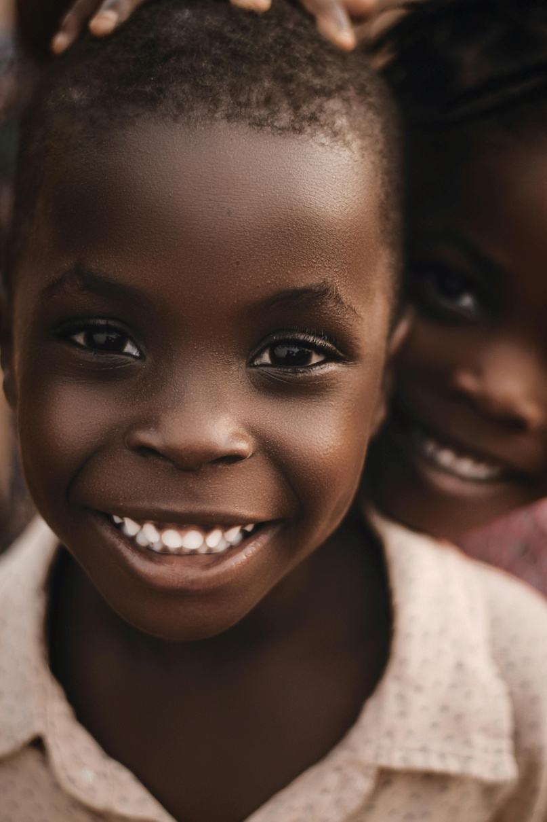
In 2015, all Caribbean nations committed to working toward the achievement of the UN Sustainable Development Goals.
Work has been steady but progress has been hampered by the social, economic, political and climatic factors.
      The effects of these have the potential to be devastating and long-lasting

Slide 6
Clarion Call
“With just five years [now four] to reach the Sustainable Development Goals, we need to shift into overdrive.” António Guterres
Secretary-General, United Nations

Slide 7
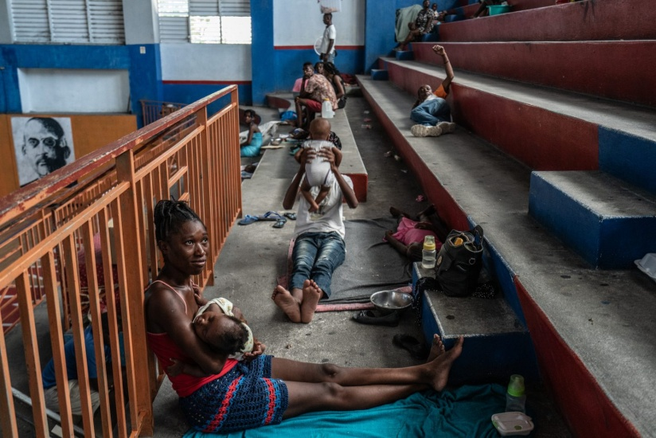
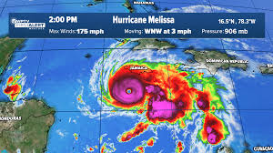
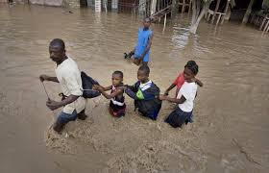
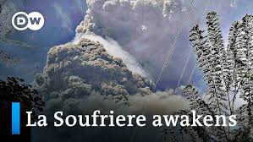
Though accurate, this statement paints an unrealistic picture given the contextual realities faced by the Caribbean region

Slide 8
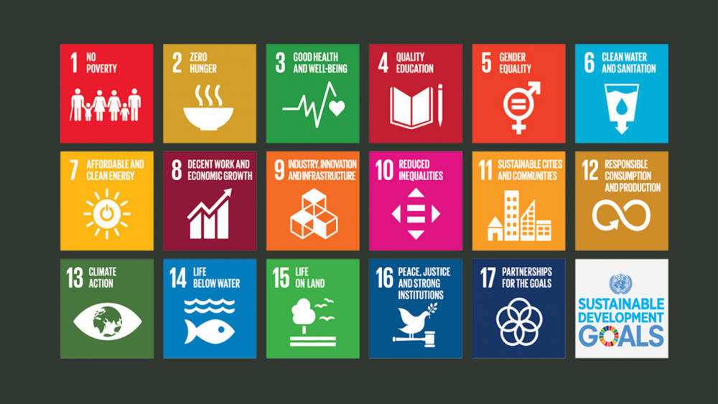
Sustainable Development Goals

Slide 9
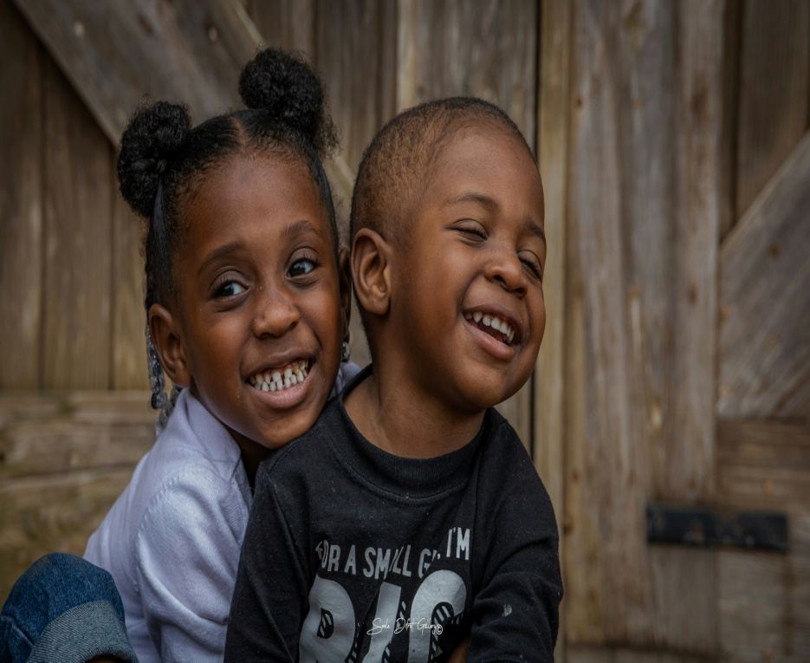
Declaration of Our Global Commitment to Children
We resolve, between now and 2030, to end poverty and hunger everywhere; to combat inequalities within and among countries; to build peaceful, just and inclusive societies; to protect human rights and promote gender equality and the empowerment of women and girls; and to ensure the lasting protection of the planet and its natural resources. We resolve also to create conditions for sustainable, inclusive and sustained economic growth, shared prosperity and decent work for all, taking into account different levels of national development and capacities.

Slide 10
Facts
Early childhood care and education has the potential to transform the lives of children from disadvantaged circumstances (Adverse Childhood Experiences)
World Bank reports globally, 350 million children (40% of children under 5 years) need access to child care but they are unable to.
Fundamentally, the children who need to benefit from ECCE the most are usually the ones who do not have a chance to access it.
As a region, we have all “committed” to advancing ECCE, but countries are at different points in achieving this endeavour.

Slide 11
Kinkead-Clark, Burns and Abdul-Majied (2019) noted the importance of early childhood care and education in helping children actualise their Rights (CRC).
  Removing the cloak of children’s invisibility
  Ensuring access and equality
  Protecting our children

Slide 12
Within this context we also understand that while achieving the SDGs particularly Goal 4, it is also likely to have ripple effects.
  Poverty, health, reduced inequalities etc

Slide 13
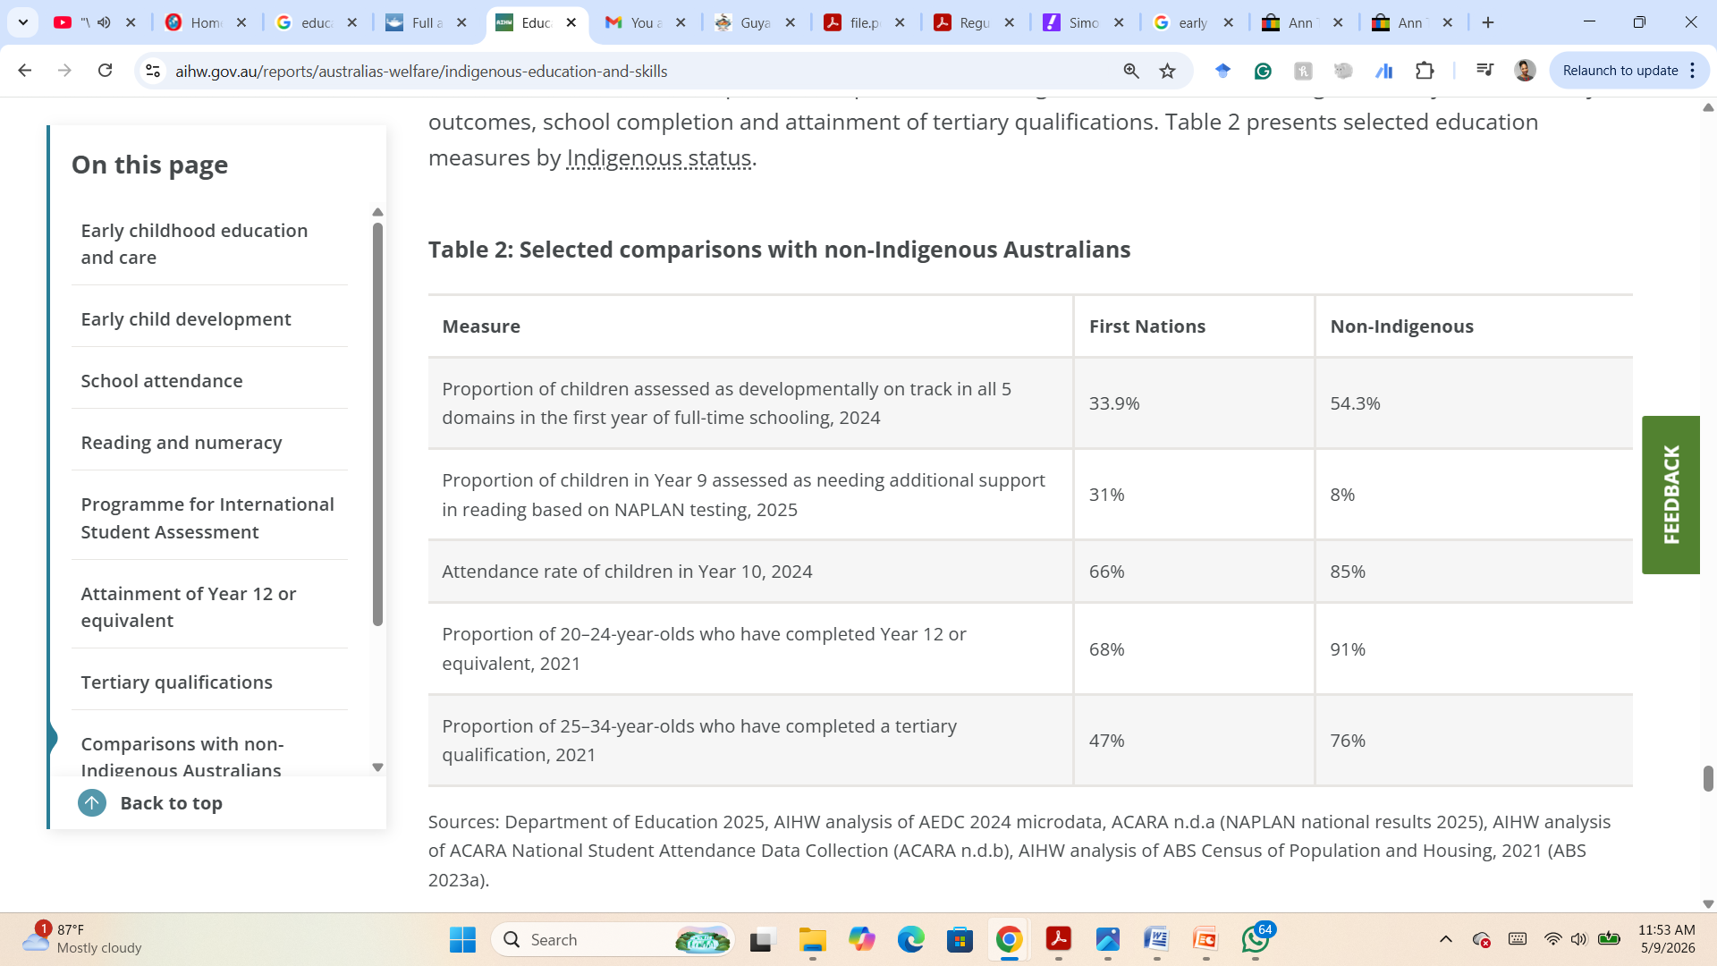
Global evidence of the underperformance of Indigenous Children

Slide 14
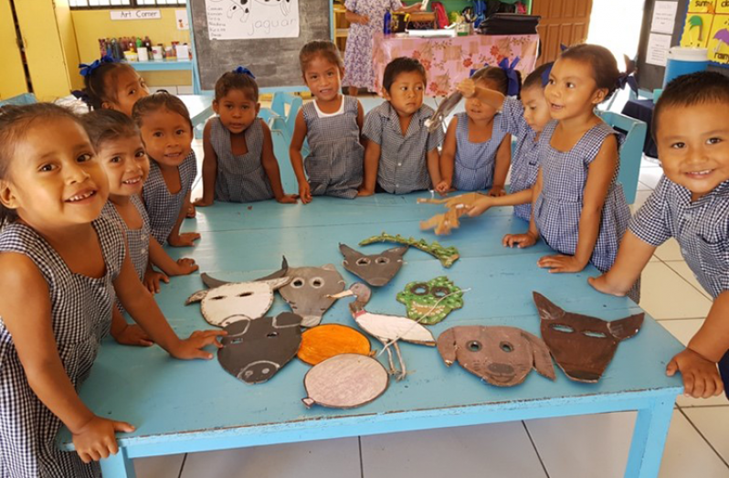
Guyana has made over the past twenty years as it has worked toward expanding access to early childhood care and education programmes for young children. Beyond increasing the number of nurseries across the country, Guyana has also been intentional in their effort to improve opportunities for Indigenous Peoples as detailed in the “2017 - Guyana Education Sector Improvement Project: Indigenous Peoples Plan”.

Slide 15
2018- Ministry of Education’s US$1.7M Guyana Early Childhood Project (GECEP) which targeted 8,000 children in hinterland and remote riverine areas was deemed successful with significant improvements in teaching and learning.

Slide 16
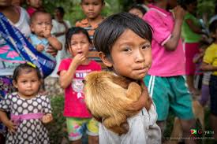
Priorities in Indigenous Education

Slide 17
Examples of Priorities in Indigenous Education
Priorities have often centred on “righting wrongs”, addressing social challenges, and in promoting “Westernised approaches to education”.
Panama- Early childhood education attendance is low due to a lack of school availability, with 30% of children in remote areas missing out on preschool (Borgen, 2026)
Australia- areas for action and improvement include early childhood education and care, school readiness, special education, school attendance and achievement

Slide 18
Within the context of Guyana, improving Indigenous education in the early childhood years focuses on four primary factors-
  Access
  Quality
  Cultural relevance
  Sustainability of efforts

Slide 19
General Statistics
72% of early childhood (nursery) teachers are untrained.
“One very significant issue is the fact that although the gross enrolment ratio at the nursery level is about eighty percent, the most vulnerable groups are not being captured. These include children in 23 remote communities, where a majority of the population is indigenous. -In Region 1, for example, there are 42 villages with primary schools but there are only 21 nursery schools/classes in the Region”. (GESIP - Legal and Institutional Framework Applicable to Indigenous Peoples and Education)

Slide 20
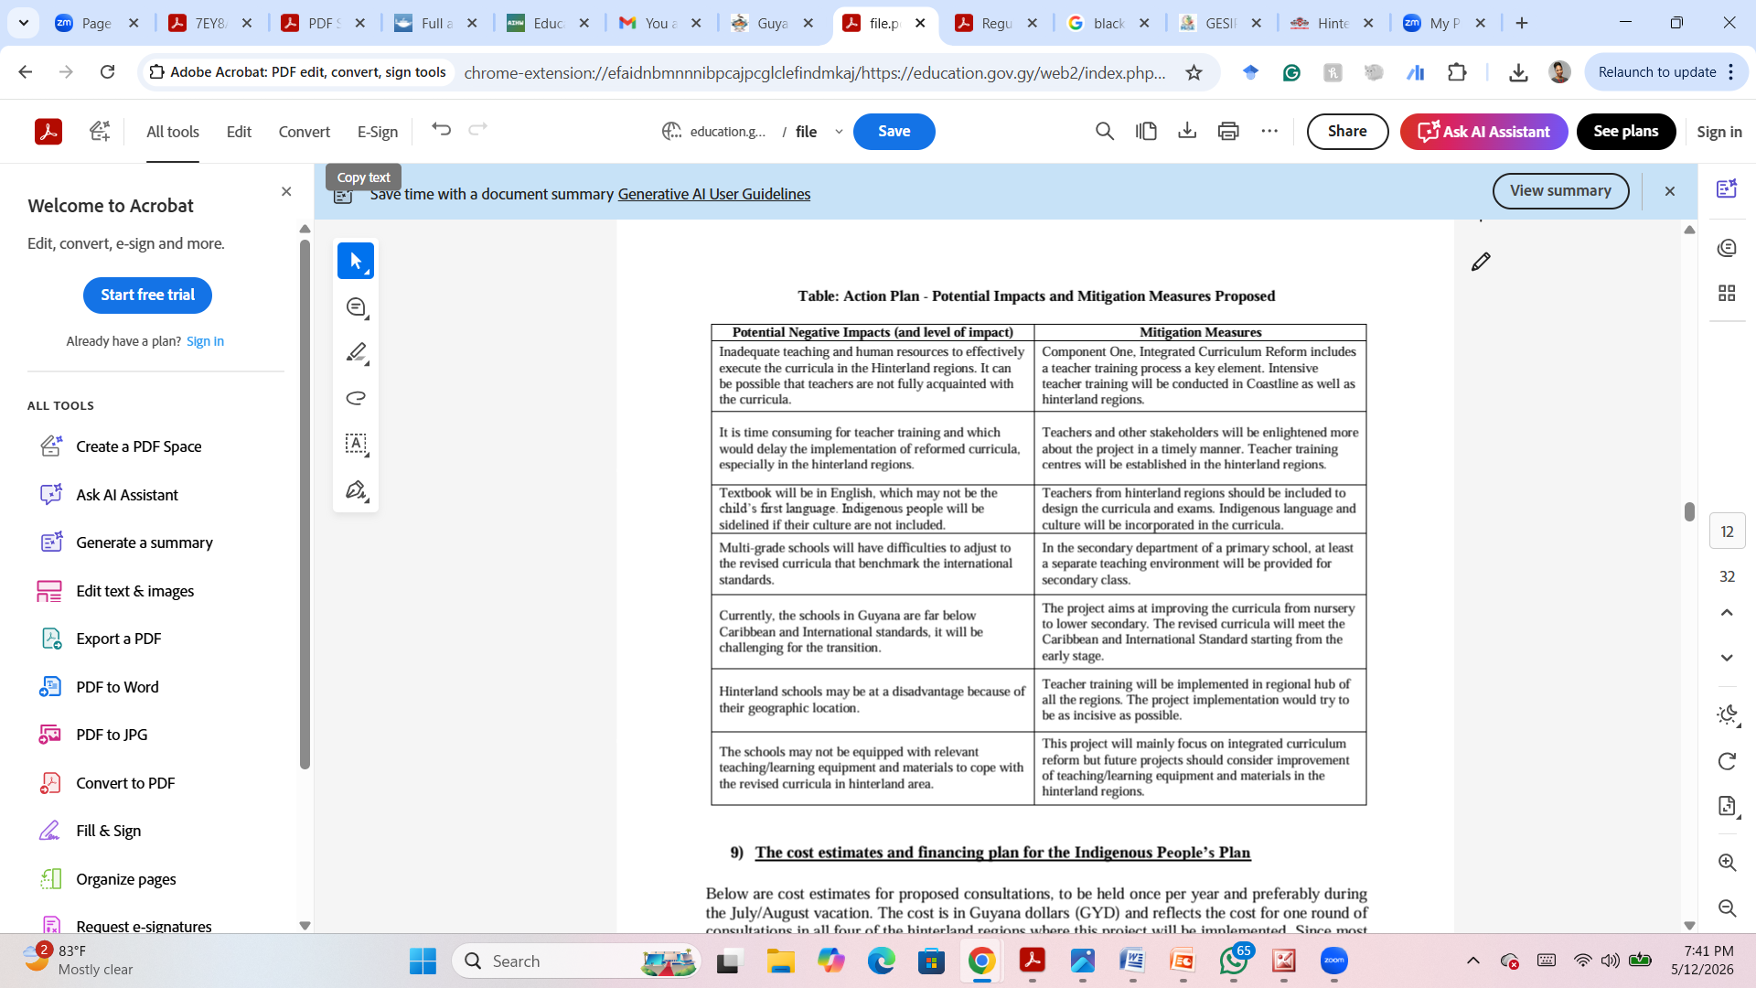
Mitigation plans

Slide 21
Some of the questions which will guide the study
What does early education look like for indigenous children?
What enablers and constraints have shaped the education of indigenous children in Guyana over the past nine years?
What is the role of parent education in advancing early care for indigenous children?
What supports are in place for children with special needs?
In what ways can support for children zero to three improve their general outcomes?

Slide 22


