Slide 1
Rooted in Place: Indigenizing ECE Curriculum in Jamaica
University of Guyana
May 15, 2026
Suzette Kelly-Williams, PhD

Slide 2
A trip Down memory lane
It is morning in rural St. Ann, and Miss Lingo has brought us outside, not because the classroom could not hold us, but because the land itself was part of the lesson. We sat beneath open sky, on ground that knew our families, in a community that breathed and hummed with life. The air carried the smell of damp earth and woodsmoke, and all around us, the landscape spoke in its own tongue: the lilting calls of birds threading through the trees, the stubborn bray of a donkey somewhere down the road, goats pulling at grass with quiet insistence, a dog announcing itself to the morning.
At first, it was all sound - wild, layered, alive.
But then came Miss Lingo's voice. Warm as sunlight on stone. Playful and purposeful. She sang her instructions to us, and in doing so, she taught us something more profound than the words themselves: she taught us to listen - to filter the rich chorus of our environment, to find meaning within it, to belong to it and learn from it all at once.
She was not merely a teacher. She was a bridge between the child and the community, between knowledge and place, between the formal and the deeply familiar. Her motherly presence did not diminish the rigour of learning - it rooted it.
My early childhood education at Bamboo Basic School in rural St Ann, Jamaica was not delivered about my community. It was delivered within it, through it, because of it.
This is an example of education rooted in place.

Slide 3
What Does "Indigenizing" Mean?
Integrating indigenous worldviews, knowledge, languages, and pedagogical approaches to create a more holistic, relevant, and culturally responsive experience for young children.
Indigenizing is not about rejecting rigor or global knowledge, it is about ensuring that the curriculum is of the place, not merely in it.

Slide 4
Key Components
Place-based learning
Oral tradition and stories
Holistic development
Intergenerational learning
Language acquisition

Slide 5
Where are we now?
ECE in Jamaica
ECIs
  Basic Schools
  Infant Schools
  Infant Department
  Nursery/Daycare Centre
  Kindergarten/Prep

Slide 6
Curriculum
Birth to age 3
Four- and Five-year-olds
Caribbean EC Learning Outcomes: Wellness; Intellectual Empowerment; Valuing Culture; Resilience; Respect for self, others, and the environment; Effective communication

Slide 7
Strengths
The JECC demonstrates several positive features:
Recognition of Jamaica's multicultural heritage through the "Out of Many, One People" framework
Explicit content on African heritage including food (ackee, yam, okra), music (drums, Anansi stories), clothing, and hairstyles
Attention to diverse ethnic contributions from India, China, Europe, and the Middle East
Integration of Jamaican folk songs, ring games, and cultural practices
Emphasis on positive self-identity and celebration of physical features across all skin tones
Play-based, child-centered pedagogical approach
Recognition of Louise Bennett's poetry and Jamaican Creole in some cultural activities

Slide 8
Gaps and Colonial Legacies
Absence of indigenous (Taino) heritage
Problematic treatment of language
Eurocentric child development framework
Colonial songs and references
Limited critical engagement with history
(Escayg & Kinkead-Clark, 2018).

Slide 9
Rooted Curriculum
Examples and Possibilities A picture of what an indigenized ECE curriculum could look like in Jamaica.
language and literacy (valuing Patois alongside Standard Jamaican English),
storytelling and oral traditions,
local ecology and place-based learning,
community and family as curriculum, and
cultural practices like music, food, and celebration as pedagogical tools.
Examples from other Caribbean territories that have successfully indigenized their early childhood frameworks.

Slide 10
The Way forward
A curriculum that sees Jamaican children fully - in their language, their culture, their community, and their potential.

Slide 11
Decolonizing Teacher Education
Reforming how teachers are prepared
Current Problem: Teacher education programs rely predominantly on American & European theorists - Bruner, Piaget, Bronfenbrenner, Vygotsky, Montessori - developed without consideration of Caribbean children.
Recommendations for Decolonizing Teacher Education
01
Culturally Responsive Preparation
02
Define Caribbean Best Practices
Teachers must be prepared to teach in the contexts they will work in. Education must reflect the needs and realities of Caribbean children (Gay, 2010).
Develop and promote our own vision of ECE best practice — not borrowed from 'first world' standards that Jamaican teachers feel pressured to imitate (Kinkead-Clark, 2017).
03
Revive Oral Storytelling
04
Holistic Understanding of Child Development
Anansi and Bre'r Rabbit stories are living cultural traditions. Teacher education must support authentic Caribbean storytelling as formal pedagogy (Escayg & Kinkead-Clark, 2018).
Contextualize development in Caribbean home, family, and community. Teachers need a repertoire of culturally grounded strategies (Roopnarine et al., 2006).

Slide 12
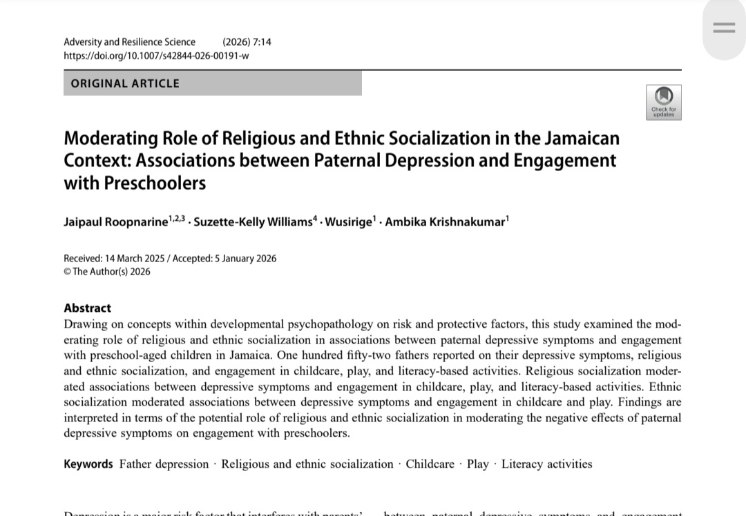
Add Local Research Literature to Teacher Education Course material

Slide 13
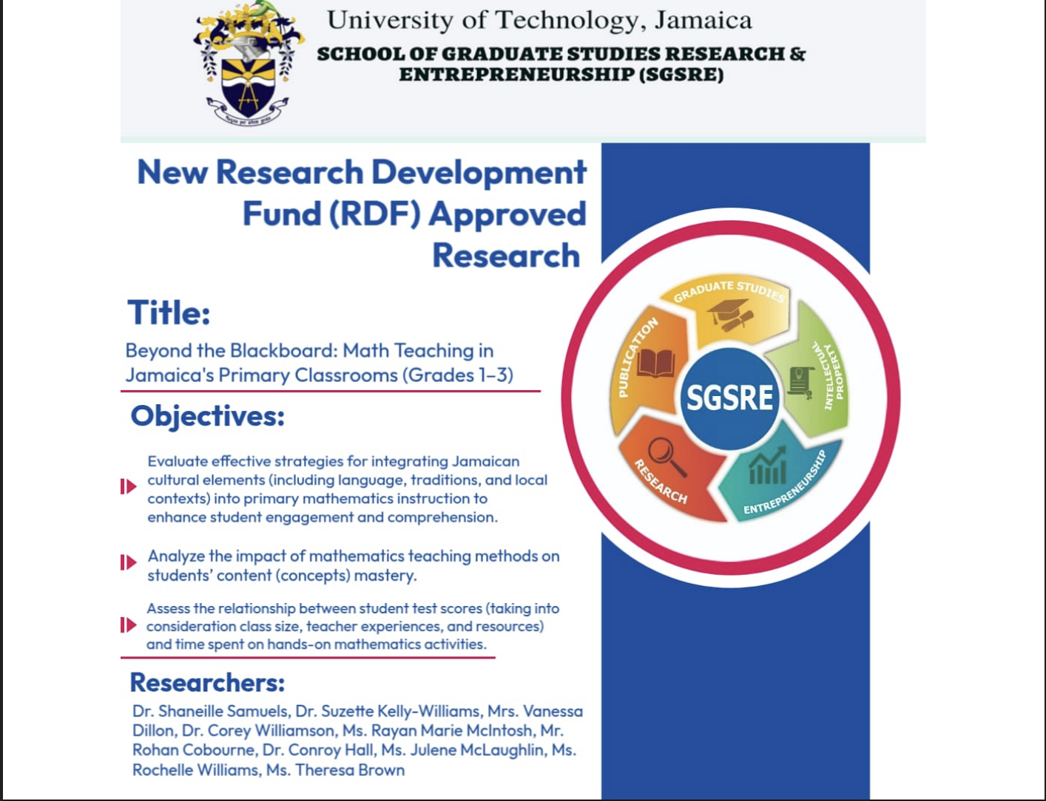
Building Local knowledge through research

Slide 14
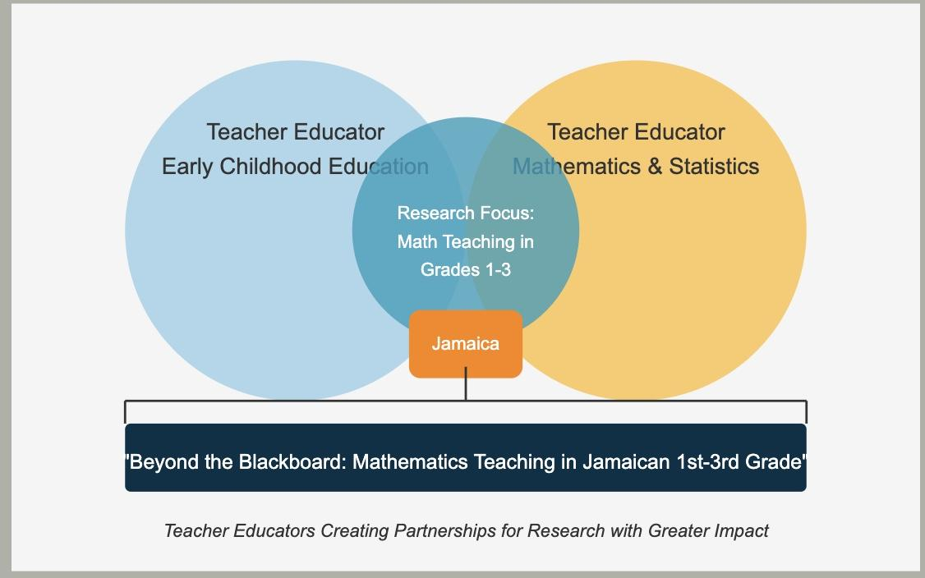
Research In Progress
Sample Research Question: To what extent does culturally relevant mathematics teaching in Jamaica impact student engagement?

Slide 15
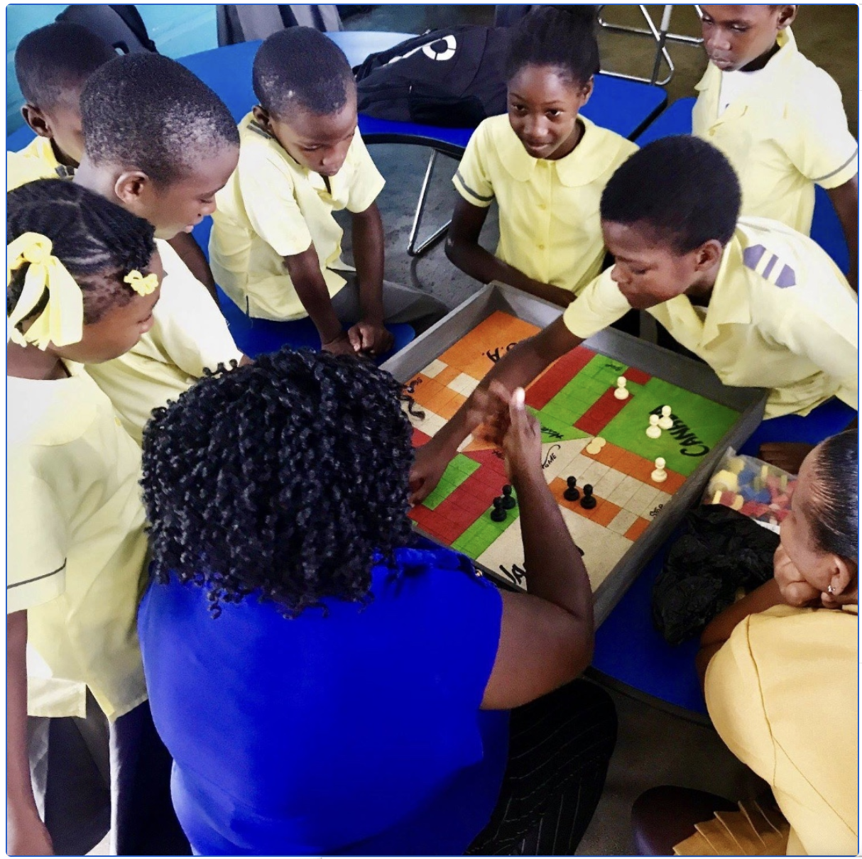
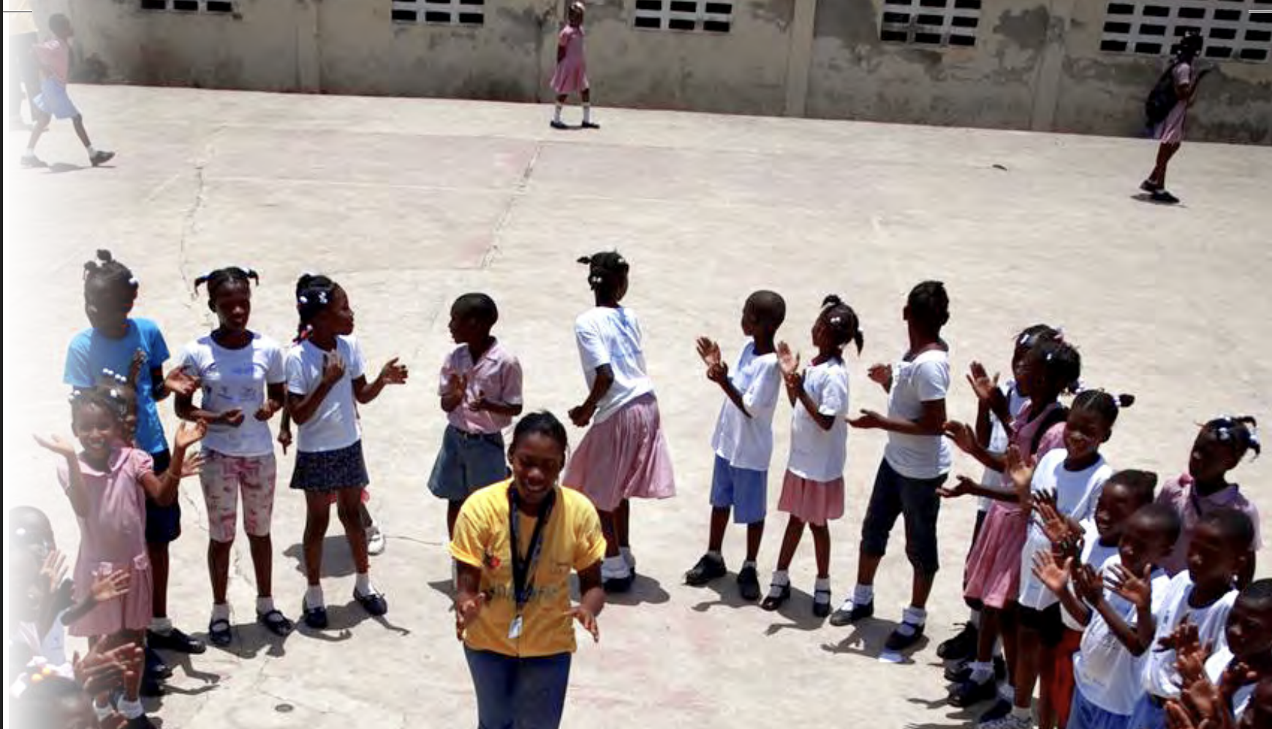
To what extent does culturally relevant mathematics teaching in Jamaica impact student engagement?
Culturally relevant items and activities | Frequency
interactive games (ludo, mini races) | 1
cake | 1
songs | 4
corner shops (understanding money, market, and grocer) | 8
worded problems/ scenarios | 9
field trips (markets/ local shop) | 5
other physical activities (queuing) | 1

Slide 16
Research Culture in Teachers’ Colleges
Extend the understanding of the Jamaican child’s development (Roopnarine et al., 2026)
Build best practices rooted in Jamaican culture (Beyond the Blackboard research)
Make cultural competence a pillar of teacher education
Resist the tokenism/superficial inclusion of culture – Jamaica Day, Heritage Week

Slide 17
